Slide 1
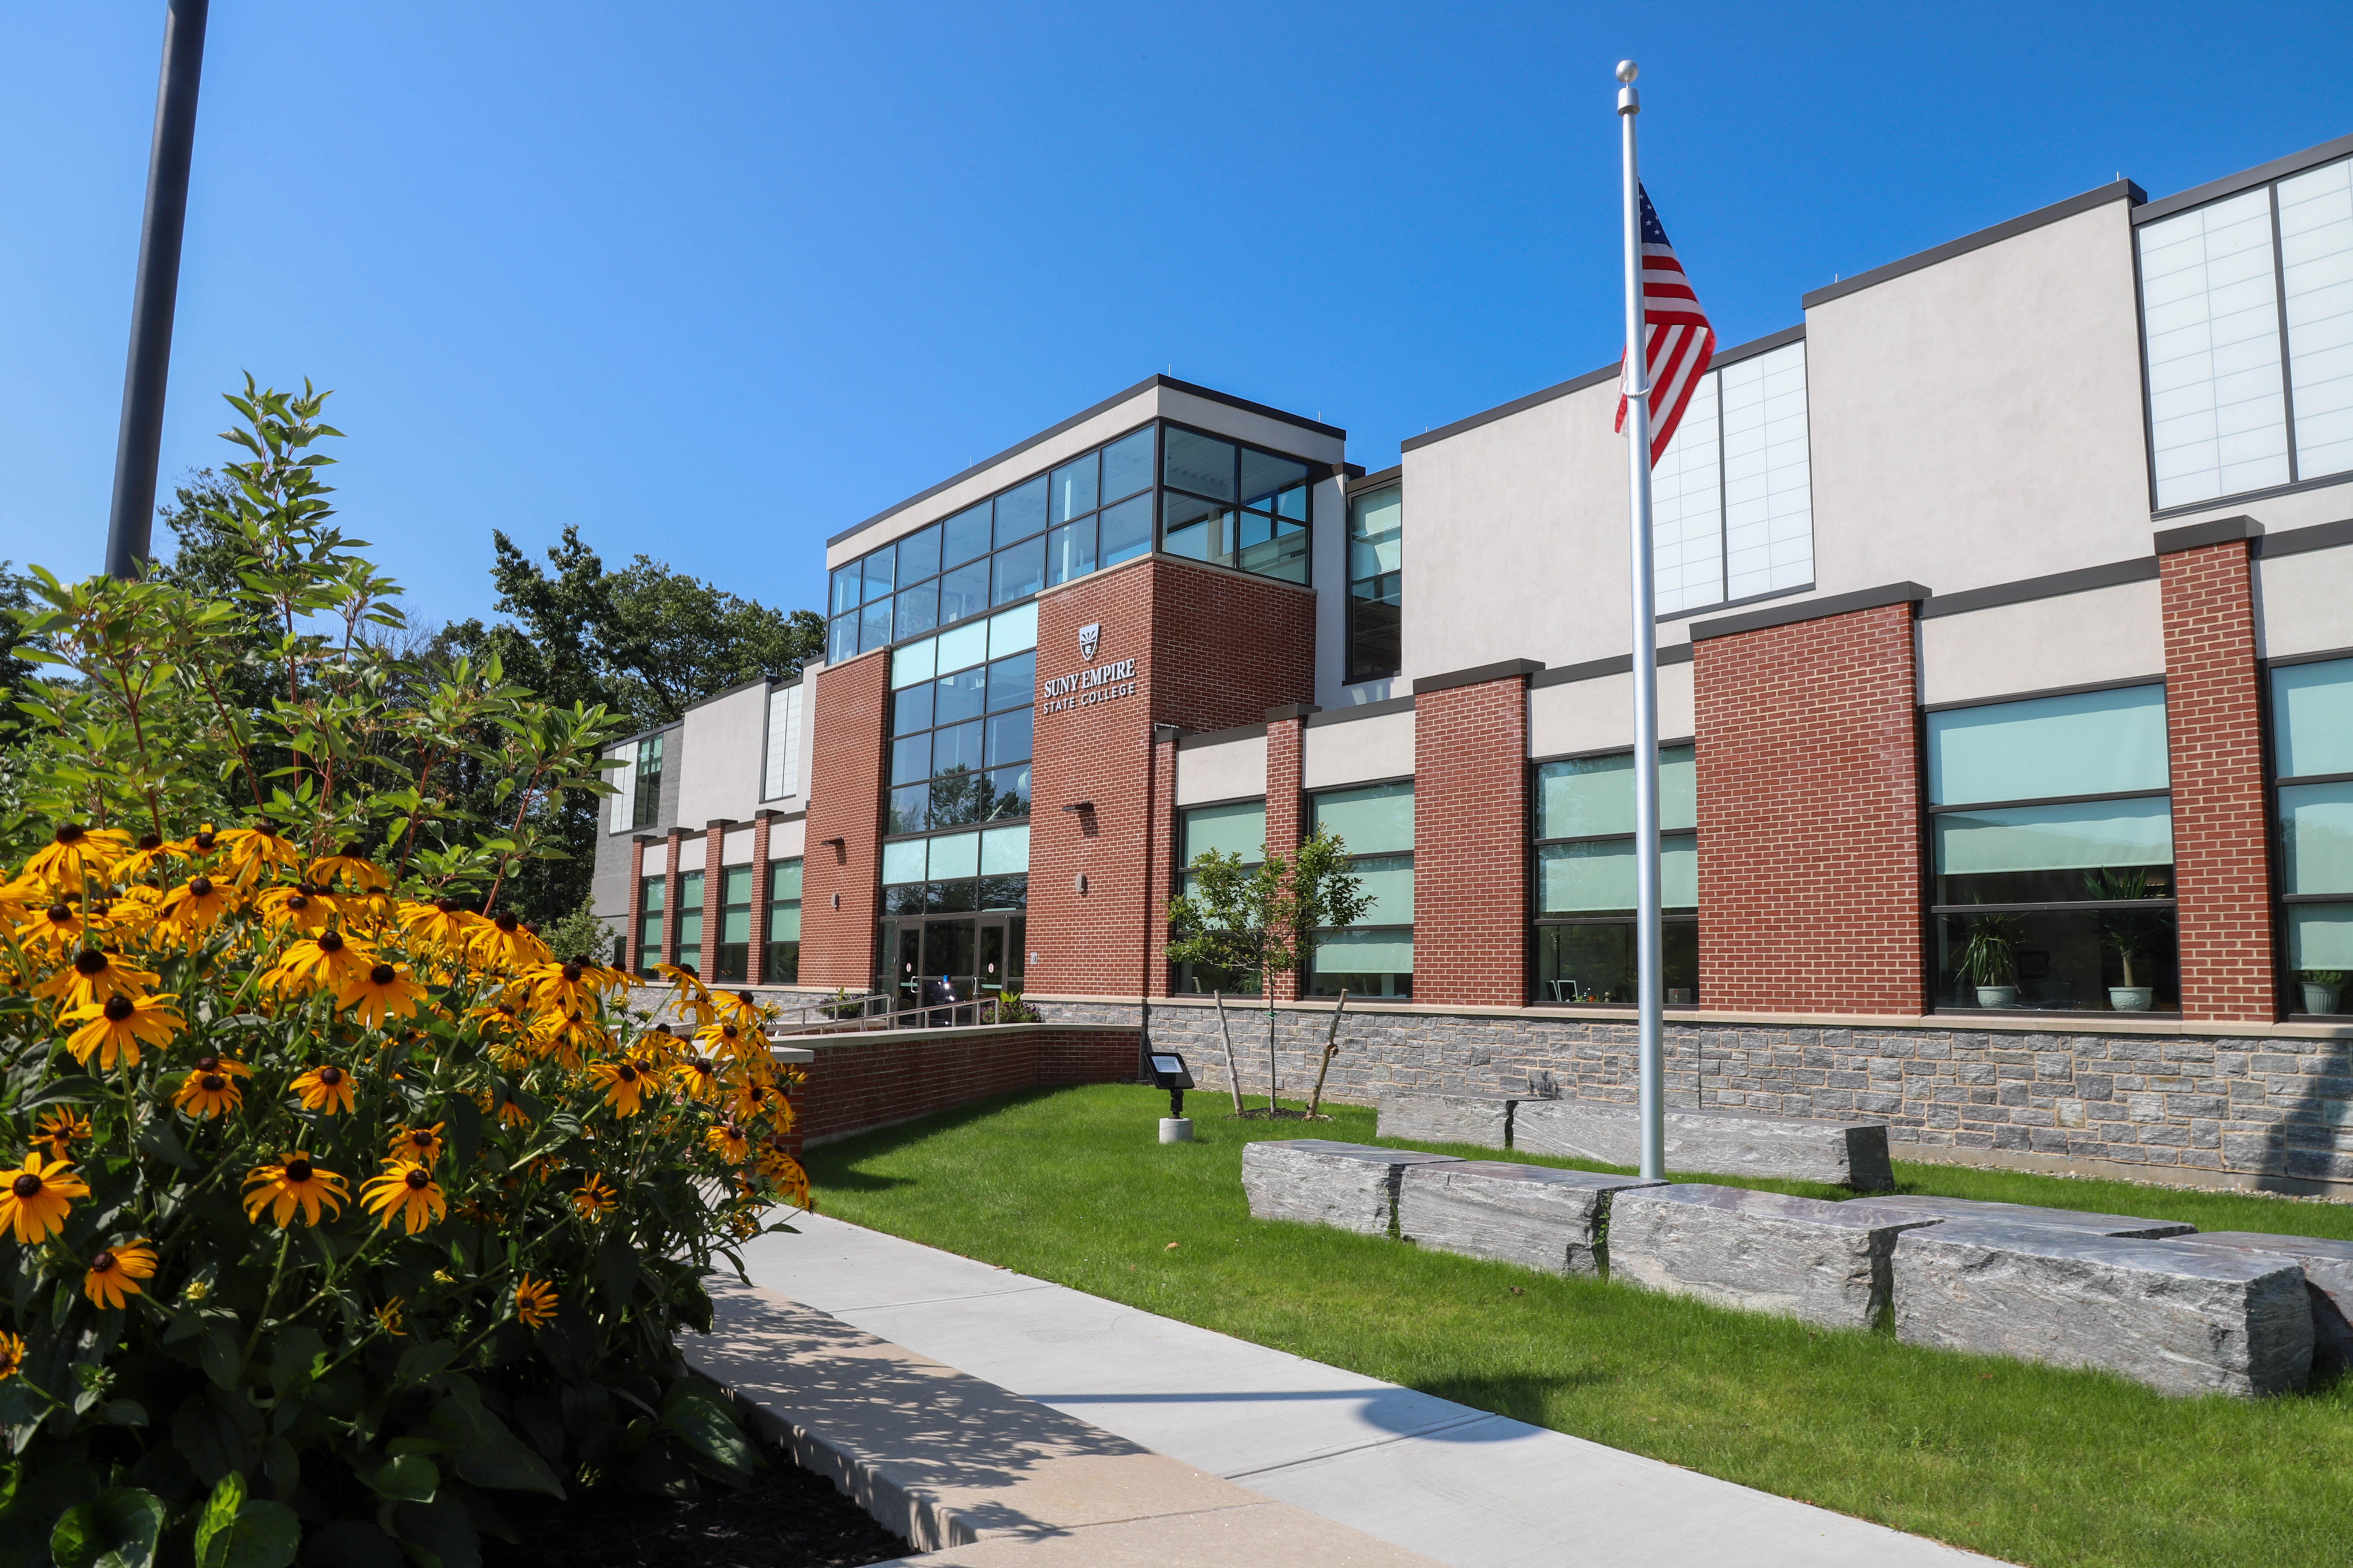
Welcome to today’s webinar
Center for Mentoring, Learning and Academic Innovation
“Degree Works and Undergraduate Students”
Amy Hemming, Assistant Registrar for Degree Works
Office of the Registrar
This webinar is being recorded.

Slide 2






Questions/Comments
To participate by chat: | Click once on the “Show conversation” icon. Type your question/comment and hit either “Enter” on your keyboard or click the send (airplane) icon. Your question/comment will be addressed in the chat or read aloud in the order of the queue by a moderator.
To participate by microphone: | Click the “Raise your hand” icon or type “hand” in the chat area. A moderator will call on you in the order of the queue. Click the microphone icon and begin speaking. Turn off/mute your mic when finished by clicking the icon again. Lower your hand by clicking on the hand icon again.

Slide 3
Agenda
What is Degree Works?
What is the plan?
How will the process change?
Who will have access?
Training
How do I find Degree Works?
What is an audit?
Q & A
Questions

Slide 4
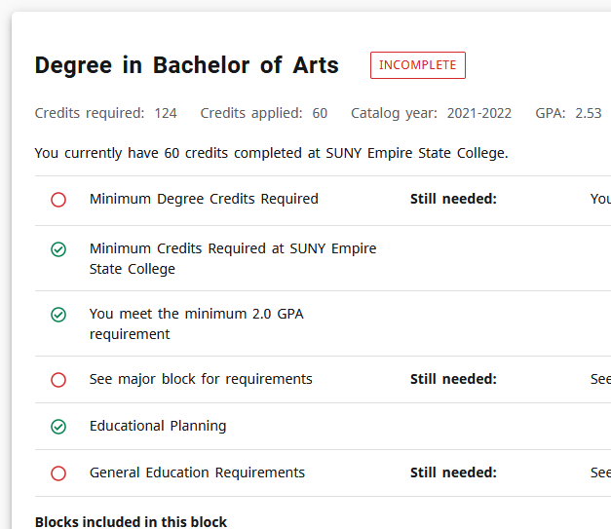
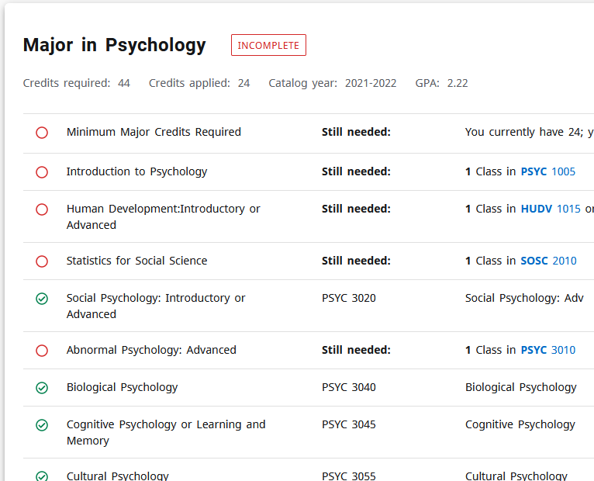
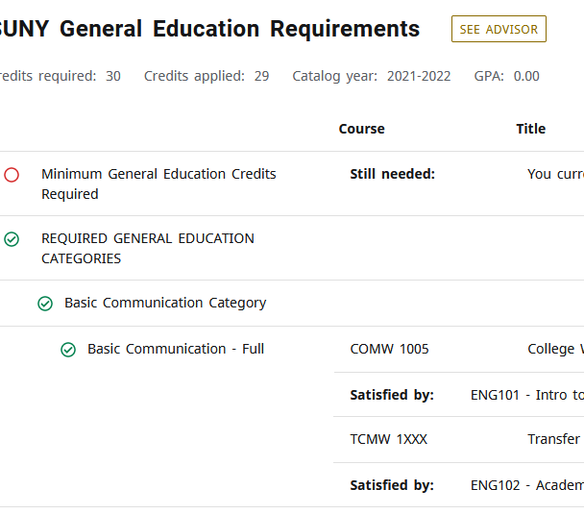
What is Degree Works?
The college’s real-time degree audit tool.
Degree
Major
Gen Ed
Web based, allows students and mentors/advisors to monitor academic progress toward completion
Structured programs will have major requirements populated from the approved curriculum.
Non-structured programs will have requirements from Concurred Degree Program.
SUNY General Education Requirements will also be listed.
Degree Works is a SUNY-wide product.

Slide 5
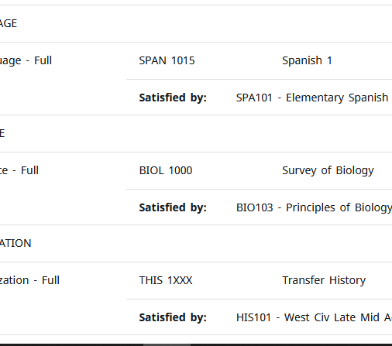

What is the plan?
Next Steps
Advanced Standing
Mentoring
Targeted rollout for undergraduate students matriculating fall 2022.
Training.
SUS students who enter the college Fall 2022 will have evaluated transcripts, allowing them to fully utilize Degree Works.
Mentoring is still important.
Educational Planning and Rationale Essay stay.
SGS & SONAH using DW since 2018

Slide 6
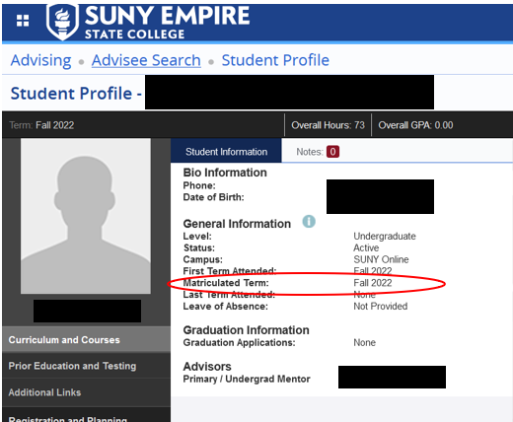
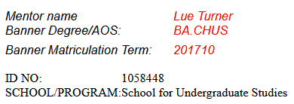
Where to find a student’s matriculation date?
SSB
DP Planner

Slide 7
Structured Programs
BA | PSYC | Psychology
BS | ADDC | Addiction Studies
BS | ACCT | Accounting
BS | MGMT | Management
BS | BADM | Business Administration
BS | HRMB | Human Resource Management
BS | CRJS | Criminal Justice
BA | LIBA | Liberal Arts
AA | GNST | General Studies
AS | GNST | General Studies
BS | SCST | Security Studies
BBA | BBAD | Business Administration
Cert | BAES | Business & Environmental Sustainability
Cert | CRPI | Crisis Prevention & Intervention
Cert | ENTR | Entrepreneurship
Cert | GIKN | Global Indigenous Knowledge
Cert | HCMG | Healthcare Management
Cert | MFMG | Manufacturing Management

Slide 8
What will change for structured programs? (Fall 2022 Matric Term)
Concurrence
Advanced Standing
Changes to Degree Audit
Structured Programs
No approval process
Based on previously approved program requirements
Fall 2022 matric term
Transcripts entered upon admission/receipt.
PLE entered upon receipt of official documentation.
PLA entered after evaluation and faculty approval. PLA will go through committee
Changes or substitutions will go through a petition and exception process.

Slide 9
Unstructured Programs
Reg Office has been using DW for Graduation
Concurrence complete (DP Planner)
Reg Office Enters DP into Degree Works

Slide 10
Updates from Banner
Degree/Major
Coursework
Advanced Standing
Degree Works
Switching programs???
Updated in Degree Works overnight

Slide 11
Who will have access?
Mentees
All Students
Self
Student
Deans
PEs/Staff
Mentors
Chairs

Slide 12
What is different (recap)?
Structured program, matric date fall 2022 → no concurred DP → use Degree Works
Petitions for changes/updates
Unstructured program, matric date fall 2022 → concurred DP in DP planner → concurred DP in Degree Works

Slide 13
What will stay the same (recap)?
Students with matric date prior to fall 2022 – need concurred DP
How students change programs
How PLA is approved*
How PLE is approved
How transfer credit is done in TES
How changes to concurred DPs are made
Ed planning
Registration
Everything entered in Banner
Mentors are important
* For fall 2022 structured will not need concurred DP

Slide 14
Training
Training
Presentations
PDFs
Videos
Orientation
FAQ: https://www.esc.edu/registrar/degreeworks-faq/

Slide 15

Field Trip
my.esc.edu

Slide 16
For More Information
FAQ: https://www.esc.edu/registrar/degreeworks-faq/
Specific Questions: Please submit a ticket

Slide 17
Questions/Comments
To participate by chat: | Click once on the “Show conversation” icon. Type your question/comment and hit either “Enter” on your keyboard or click the send (airplane) icon. Your question/comment will be addressed in the chat or read aloud in the order of the queue by a moderator.
To participate by microphone: | Click the “Raise your hand” icon or type “hand” in the chat area. A moderator will call on you in the order of the queue. Click the microphone icon and begin speaking. Turn off/mute your mic when finished by clicking the icon again. Lower your hand by clicking on the hand icon again.

Slide 18
Thank you for joining us!
The slides and recording from this webinar will be available on the CMLAI website at https://www.esc.edu/cmlai/
(see Resources -> Presentations)
Upcoming Events:
Pre-New Mentor Orientation Virtual Session I, 7/13, 2 p.m.
Reading Group, 8/15, noon.
Pre-New Mentor Orientation Virtual Session II, 8/15, 3 p.m.
Open Mic on Mentoring Practices, 8/18, noon.
Special “Open Mic” on Prior Learning Assessment, 8/25, noon.
View the entire CMLAI Event Calendar here.
Center for Mentoring, Learning and Academic Innovation (CMLAI)

