Slide 1
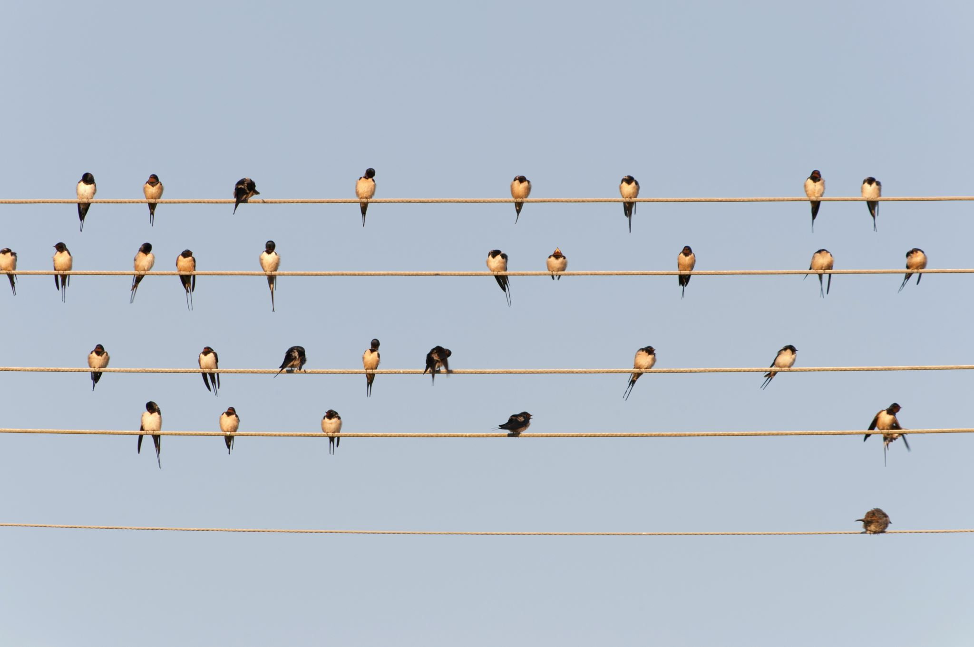
Beyond the Birdseed: How to Help Birds Thrive Earth Day 2023, SUNY Empire Sustainability Committee Mindy Boenning, April 20, 2023

Slide 2
Today we will cover:
Overview & why this matters
Bird protection
Bird feeders & water
Planting for birds
Activities to get involved in
Resources for later exploration

Slide 3
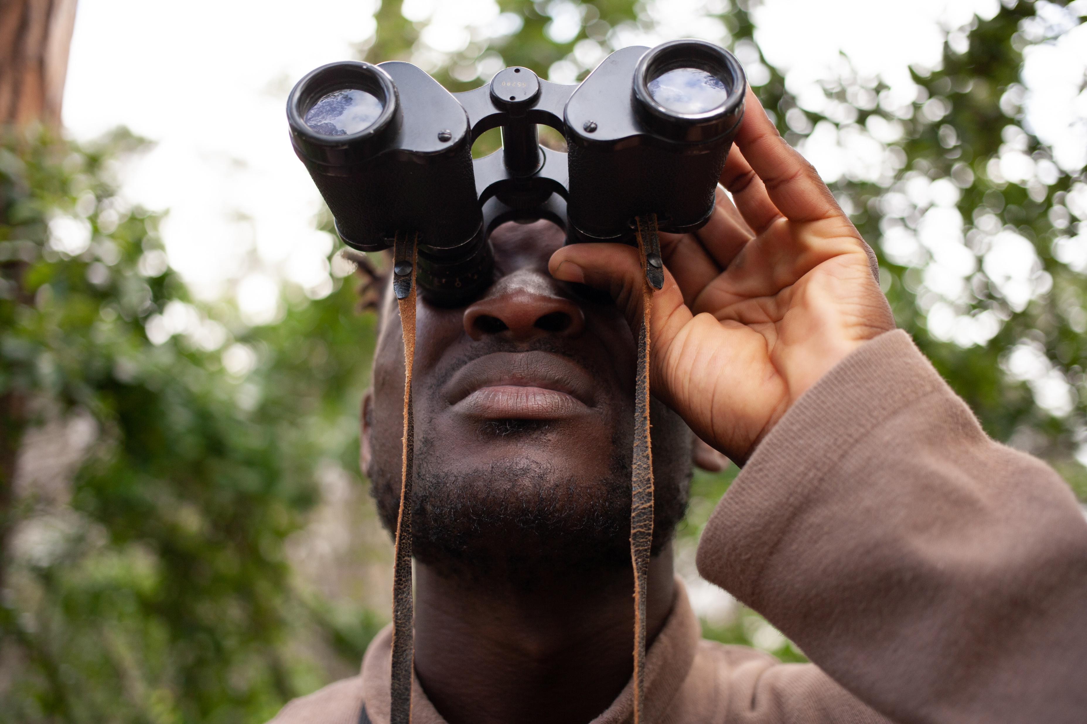
Tips for Everyone
Bird lover or not so much?
Unsure where to start?
There are tips that everyone can use to help birds even if you’re not glued to binoculars or filling bird feeders!

Slide 4
Part of a Larger Ecosystem
Everything in nature is interconnected
All wildlife has more stress & thinner margins of survival these days
Any contribution from you makes a difference
Birds need different things at different points in their life cycle and in different seasons
Adult birds
Shelter & protection
Baby birds
Habitat
Food & water

Slide 5
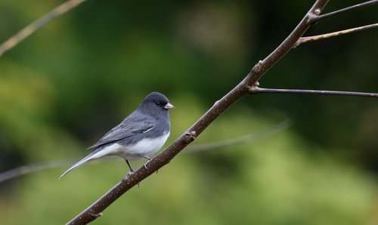
Disappearing Birds
We have 29% fewer birds in the United States and Canada since 1970
That’s almost 3 billion fewer birds across North America
Grassland birds experienced the biggest impact: 53% decline
Between 2009 to 2019, Spring migration has dropped 14% (as measured by night radar)
Study published in the journal Science, Sept. 2019
More info at https://www.3billionbirds.org

Slide 6
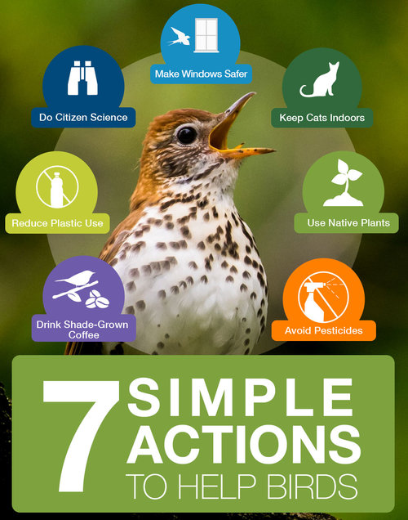
How You Can Help!
Keep cats indoors
Make windows safer
Avoid pesticides
Use native plants
Drink shade-grown coffee
Reduce plastic use
Do citizen science

Slide 7
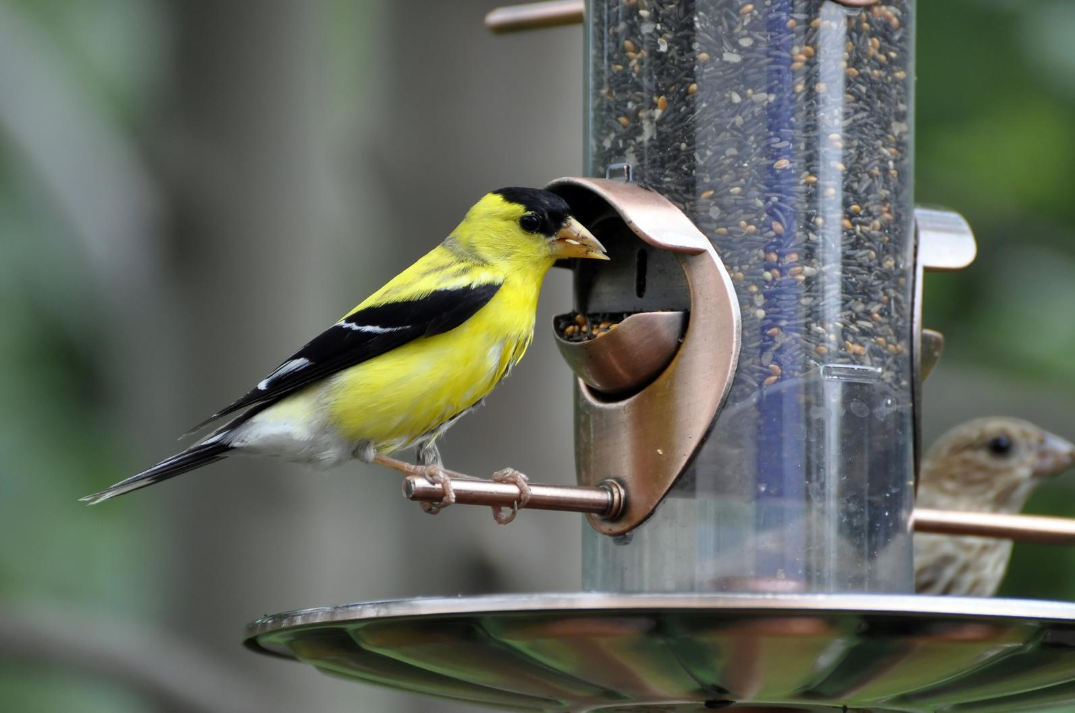
Bird Feeders
Choose right type of feeder
Platform, tube, suet, etc.
Location, location, location
Clear view from feeder, but within 12 ft. have shrub, evergreen, or brush pile
30 ft. away from windows, or within 3 ft.
Use the right birdseed mix for your location & season
Only put out enough food for 1-2 days & clean feeder regularly
Store unused seed to protect from moisture & critters

Slide 8
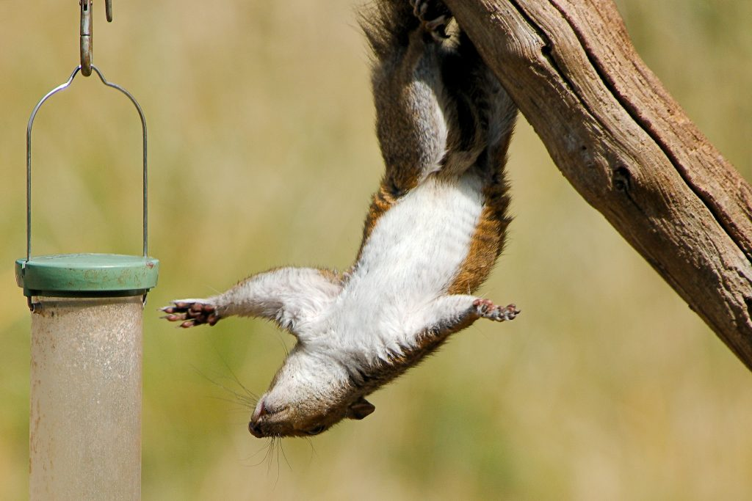
Squirrel Thieves
You may have to change tactics as squirrel figure out new strategies
Squirrels can jump
5 ft. up
7 ft. across
9 ft. down
Try hanging feeder on a thin wire between 2 poles at least 14 ft. apart; put PVC pipe or plastic bottles with both ends cut off on the wire
Use food unappealing to squirrels (safflower, white millet, nyjer seed)
Use de-husked/no-waste seed: less clutter under feeder, more invisible
Thanks to www.blog.mybirdbuddy.com for suggestions!

Slide 9
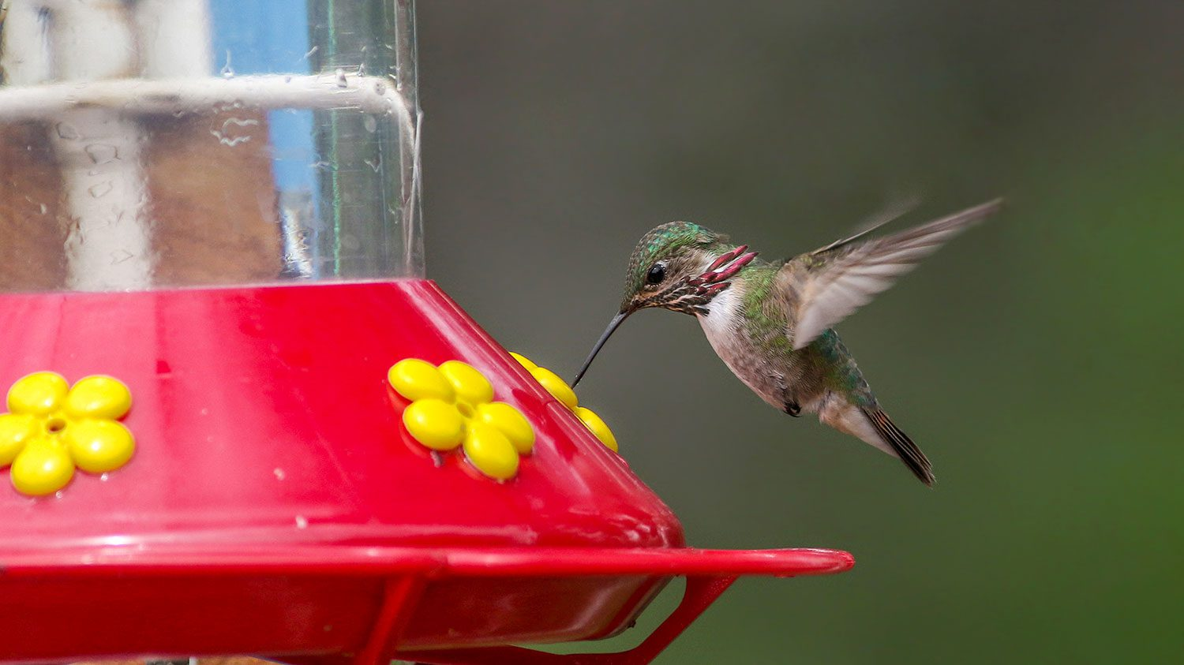
Hummingbird Feeders
Make fresh liquid every few days
Use sugar, not honey (spoilage)
Sunny weather: ¼ cup sugar to 1 cup water
Cloudy/cold/rainy weather: 1/3 cup sugar to 1 cup water
Place in the shade (spoilage)
Liquid doesn’t need to be red

Slide 10
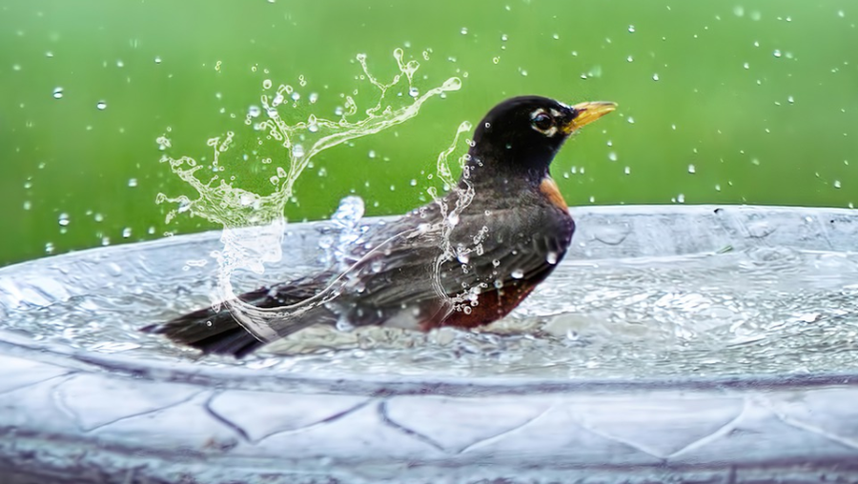
Birdbath Tips
Birdbaths provide water to drink and to bathe – both important for bird health.
Try to have your birdbath imitate a puddle – slope down to max. 2 inch depth.
Put stones or branches in the water to allow birds to drink without getting wet.
You can get a safe heater for winter.
Location: spaced away from cat hiding places
Clean the birdbath every day or two (dirt, algae, mosquito eggs)

Slide 11
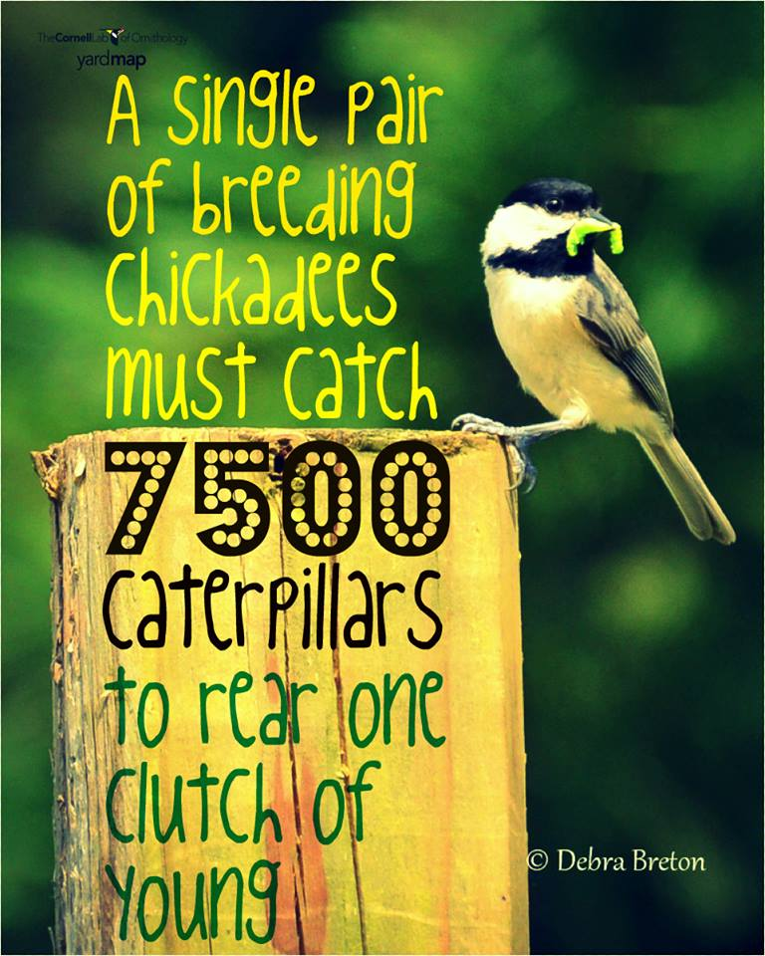
Baby Birds Need Insects
About 90% of North American land birds need insects as hatchlings. No insects = no next bird generation.
Insects need food and habitat, and you can provide that in your yard.
Many insects are pollinators, which are also in decline.
Insects & plants co-evolved, so plants native to your area are essential to protect & plant.
Choose plants that are beautiful AND are part of the ecosystem!

Slide 12
Have some fun and do some good!
Bird watching
NYS Birding Trail (parks with good birdwatching sites), including NYC areas
Web cams in bird’s nests – local or exotic birds. You can watch live, or see recorded highlights,
Walking/Hiking/Outdoors
Go solo walking or join a group
The more you’re outside, the more you learn about the animals around you
Phone apps & books to identify birds
Citizen science projects
The Great Backyard Bird Count – every February
Project Feeder Watch – every November through April
Environmental Organizations
Help construct trails, create gardens, and lots of other projects
Plant trees in your neighborhood

Slide 13
Resources
7 Simple Actions to Help Birds
https://www.birds.cornell.edu/home/seven-simple-actions-to-help-birds/
Bird identification
Merlin ID app: https://merlin.allaboutbirds.org/?utm_source=adgrant&utm_medium=cpc&utm_campaign=merlin&utm_content=birdidapp&gclid=EAIaIQobChMIvLDR-fuw_gIVxMzjBx1WsAyuEAAYASAAEgIvZPD_BwE
Sibley Guides: https://www.sibleyguides.com/about/
Audubon videos, tips, quizzes: https://www.audubon.org/birding/identifying-birds
Native plants for insects & seeds
https://www.allaboutbirds.org/news/its-true-a-yard-full-of-native-plants-is-a-yard-full-of-well-fed-birds/
https://xerces.org/pollinator-resource-center
https://homegrownnationalpark.org/find-your-resources

Slide 14
Resources - continued
Landscaping for birds
https://nestwatch.org/learn/general-bird-nest-info/landscaping-for-nesting-birds/
Birdbaths
https://www.allaboutbirds.org/news/wp-content/uploads/2009/04/BirdNote09-ProvideWater-2013-2021.pdf
Bird watching
Tips for beginners: https://www.allaboutbirds.org/news/binoculars-and-beyond-nine-tips-for-beginning-bird-watchers/
NYS Birding Trail locations: https://www.dec.ny.gov/animals/124045.html
Bird cameras:
Cornell: https://www.allaboutbirds.org/cams/all-cams/
NYS DEC, mid-Hudson bridge: https://www.dec.ny.gov/animals/34268.html
NYS birding resources, including group birdwatching events: https://www.dec.ny.gov/animals/109900.html#Events

Slide 15
Resources - continued
Citizen science projects
Great Backyard Bird Count: https://www.birdcount.org/
Project Feederwatch: https://feederwatch.org/
https://www.birds.cornell.edu/citizenscience
https://blog.nature.org/2016/03/30/7-citizen-science-projects-bird-watching-lovers-birding-birds/
Environmental organizations
Check for NYS organizations here: http://www.eco-usa.net/orgs/ny.shtml
Walking, hiking, outdoors
Outdoors groups supporting African Americans: https://outdoorafro.org/, https://www.blackgirlshike.net/ , https://www.girltrek.org/
Becoming an Outdoors Woman (NYS DEC program) (30th anniversary!): https://www.dec.ny.gov/education/68.html
Plant trees for Arbor Day: https://www.arborday.org/
NY ReLeaf Program (through NYS Urban Forestry Council & DEC) – learn about increasing trees in your neighborhood, join activities: https://www.dec.ny.gov/lands/5307.html

