Slide 1

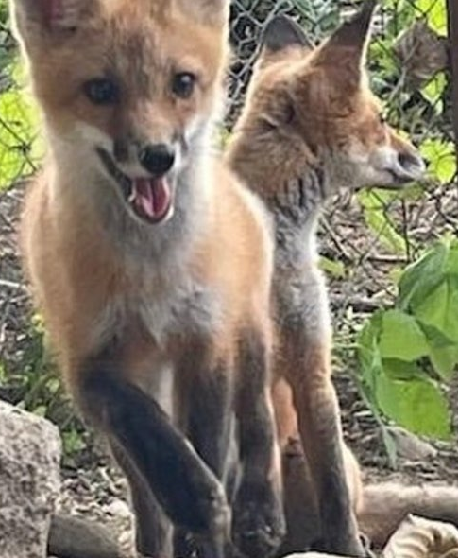
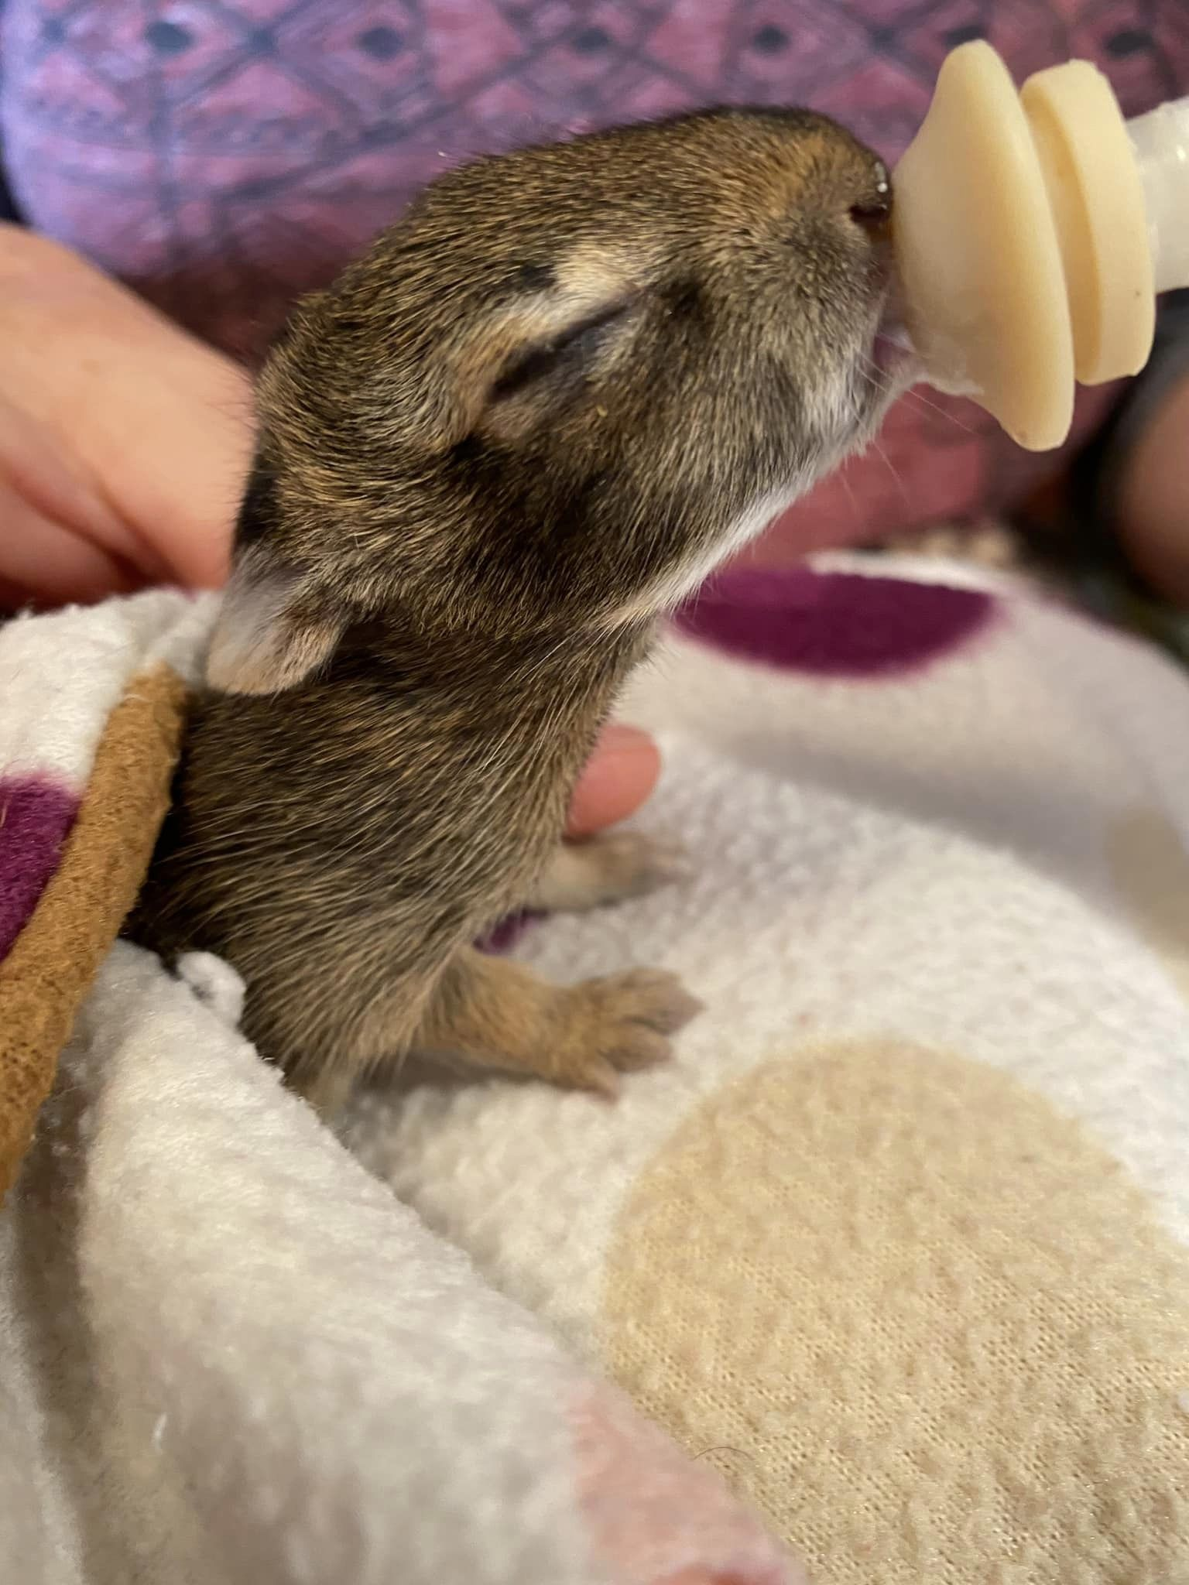
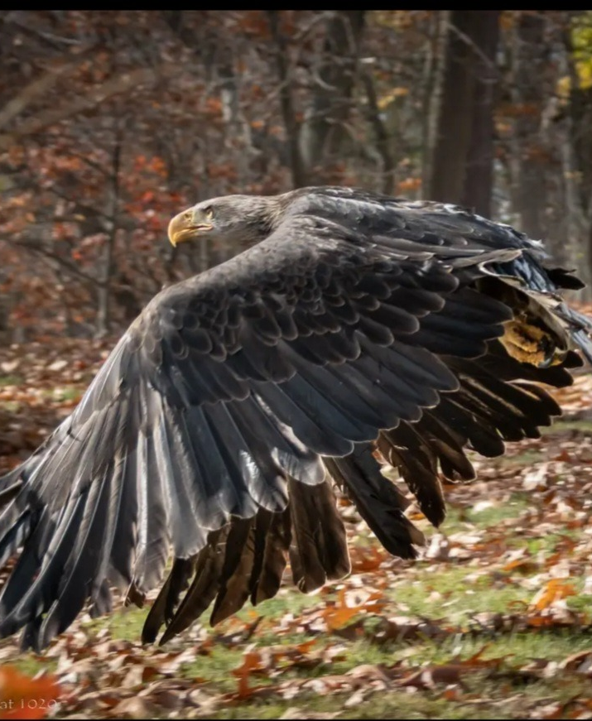

North Country Wild Care
Helping hands for wildlife in northeastern new york

Slide 2

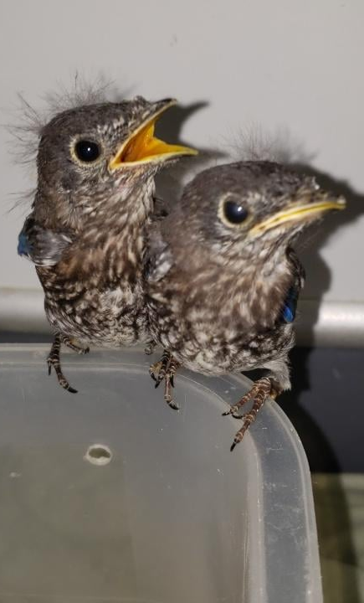
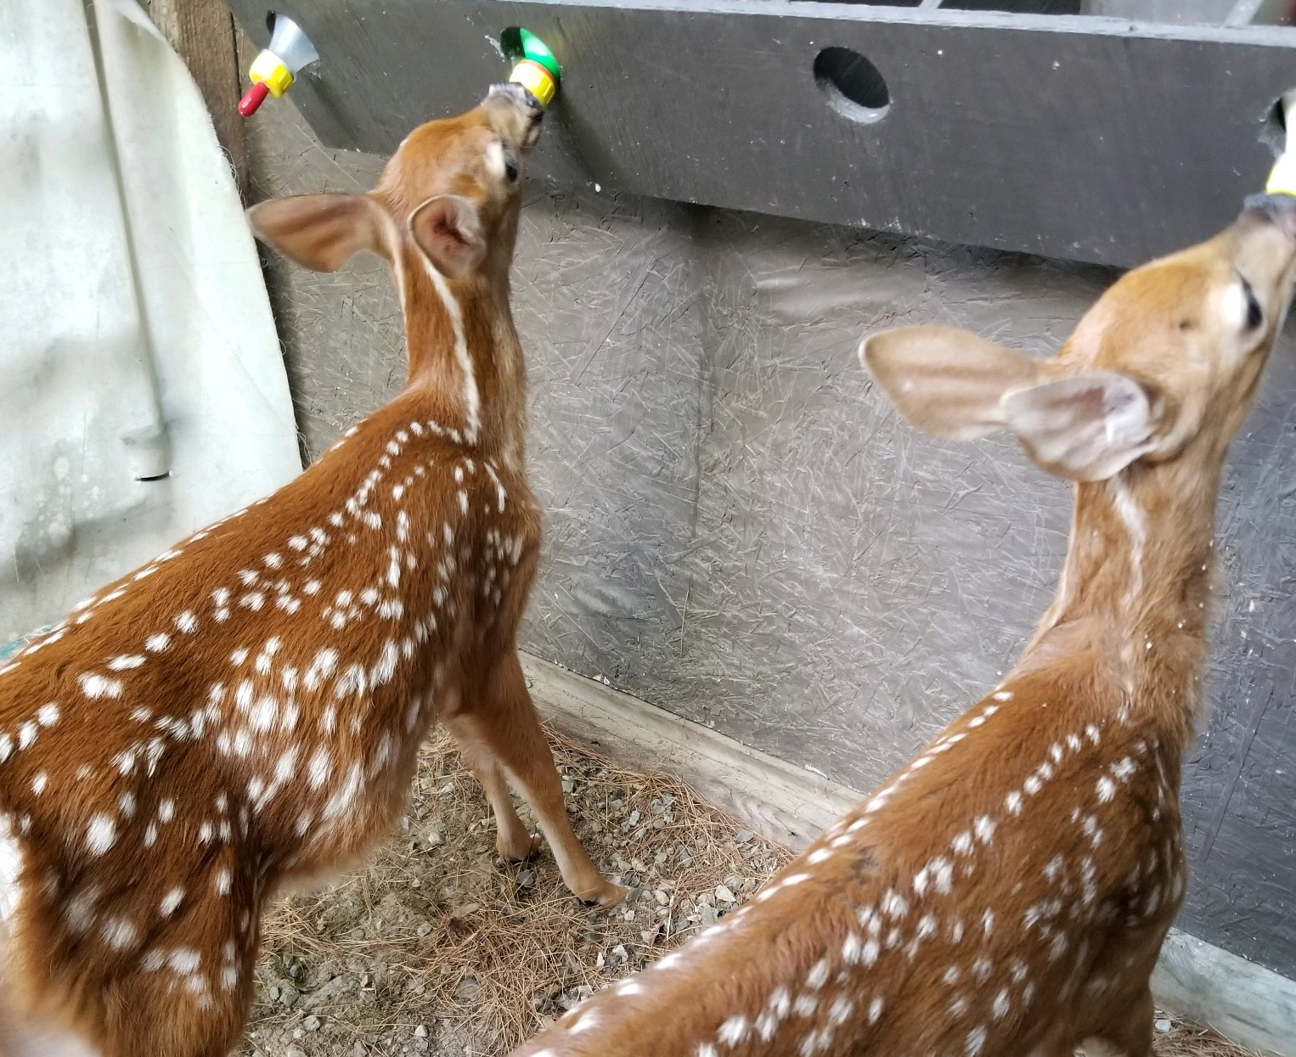
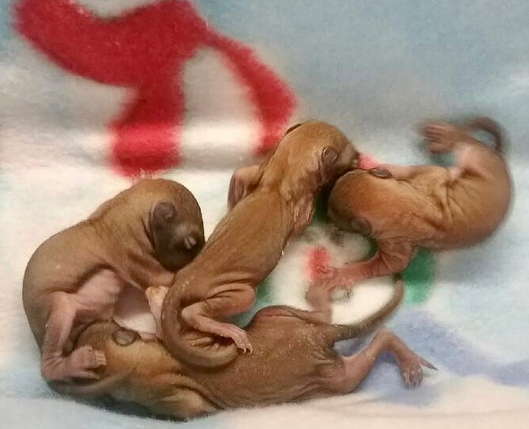



What is wildlife rehabilitation?

Slide 3
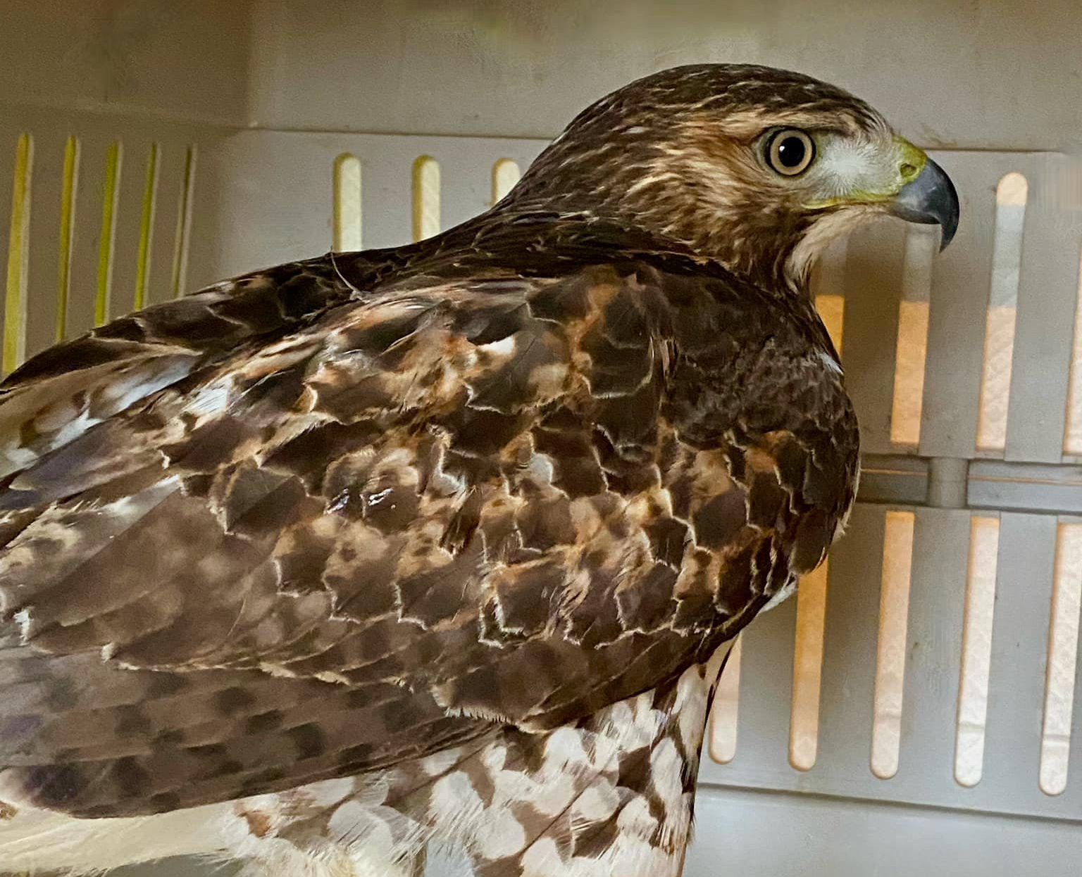
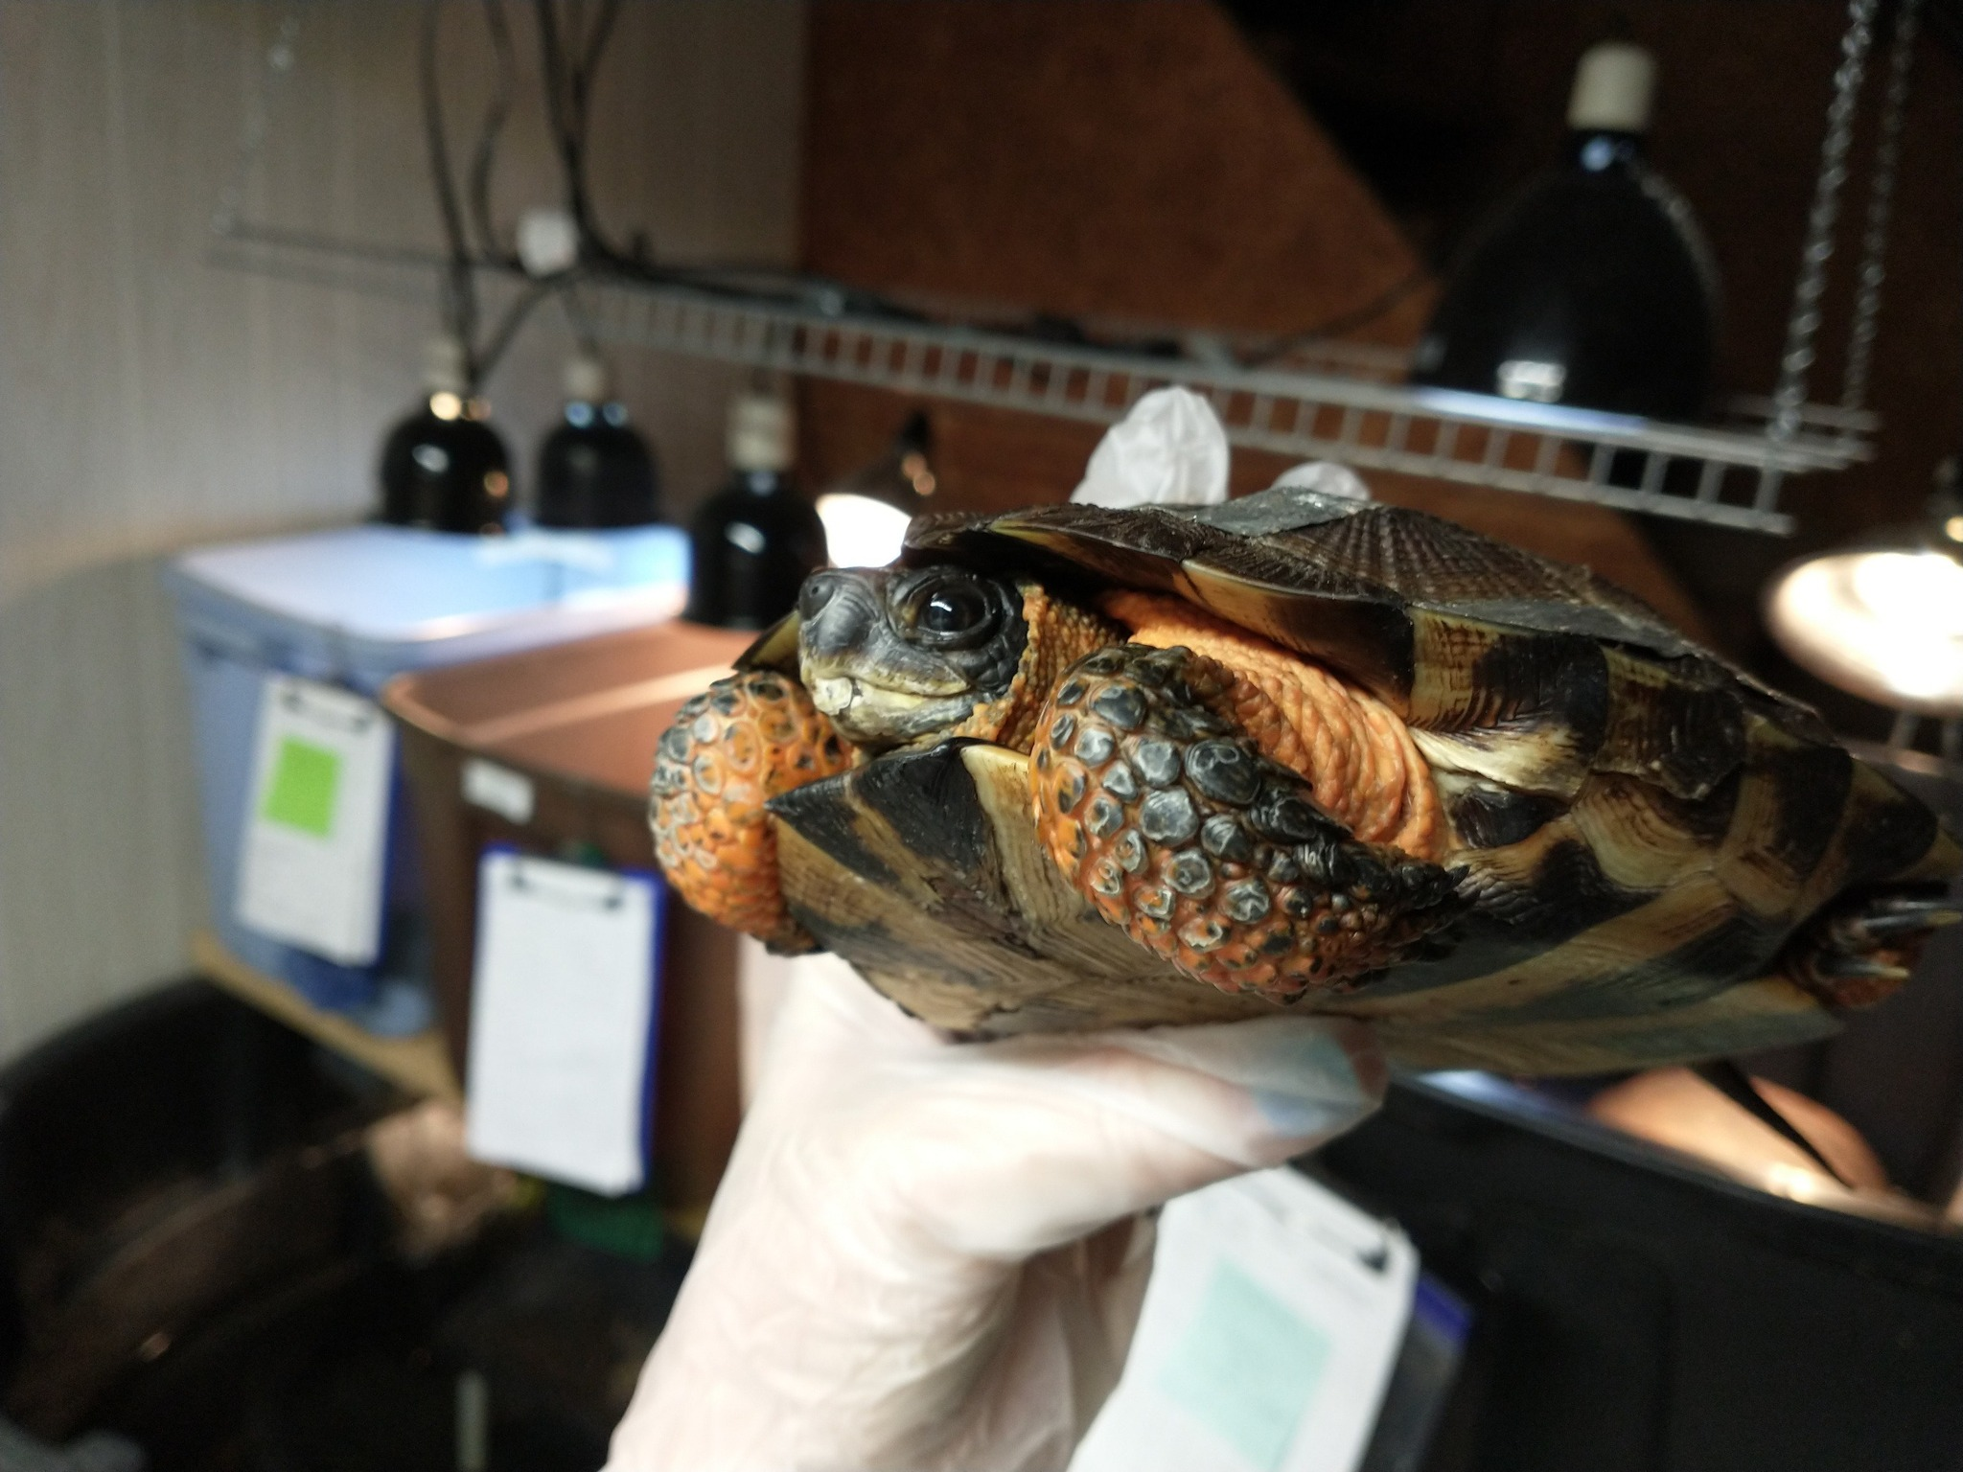
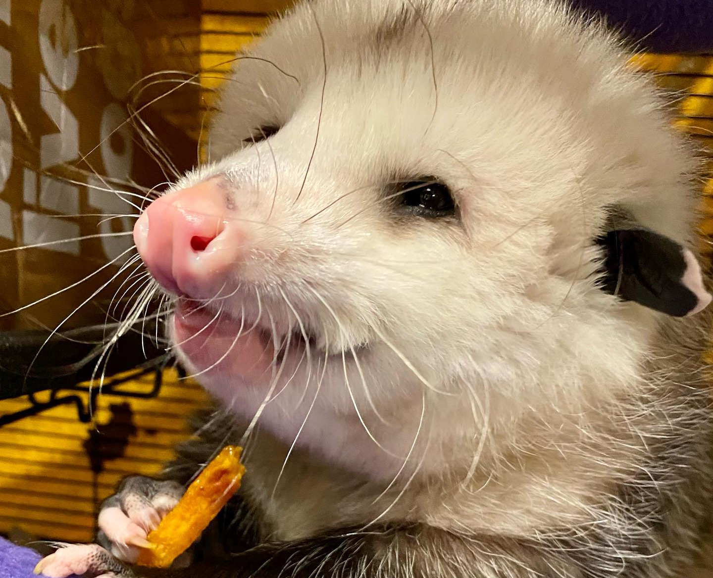
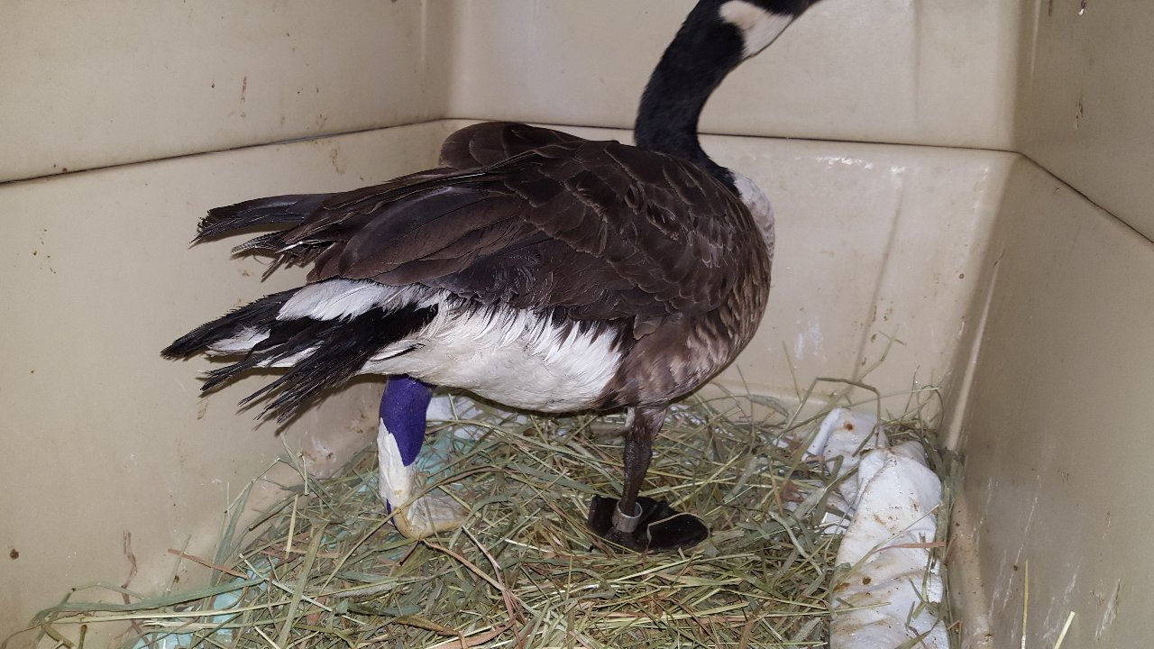
What is wildlife rehabilitation?

Slide 4
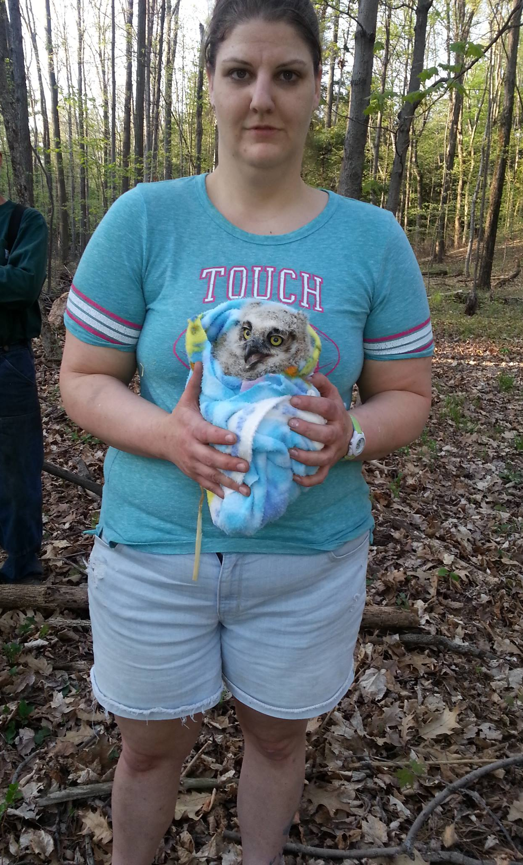
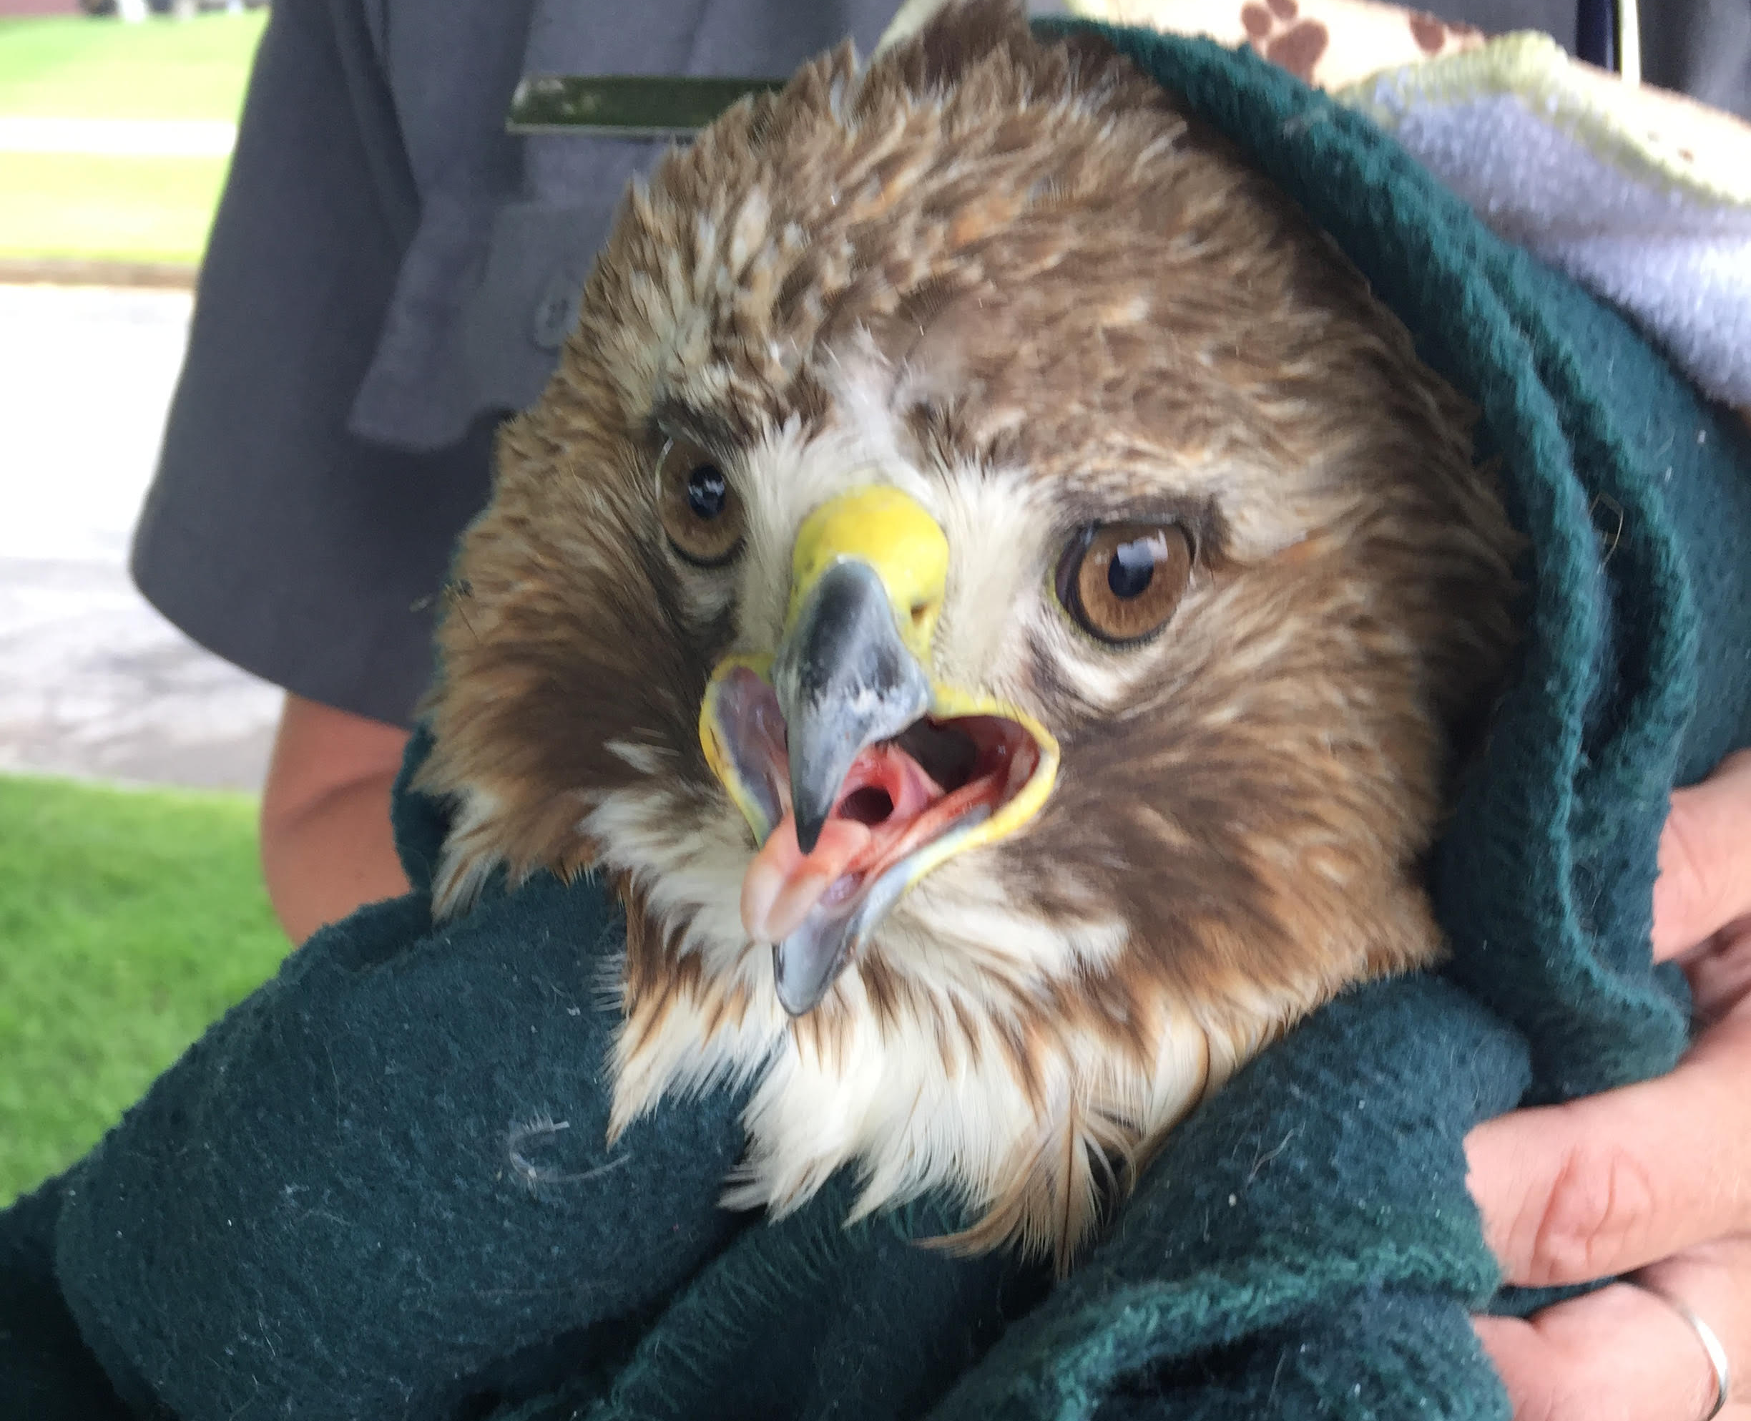
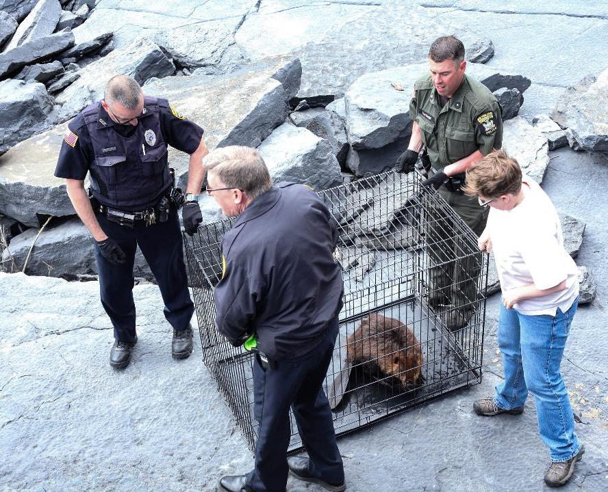
What to do when you find an injured or orphaned animal
Safety first!
Note the location
Call for help

Slide 5
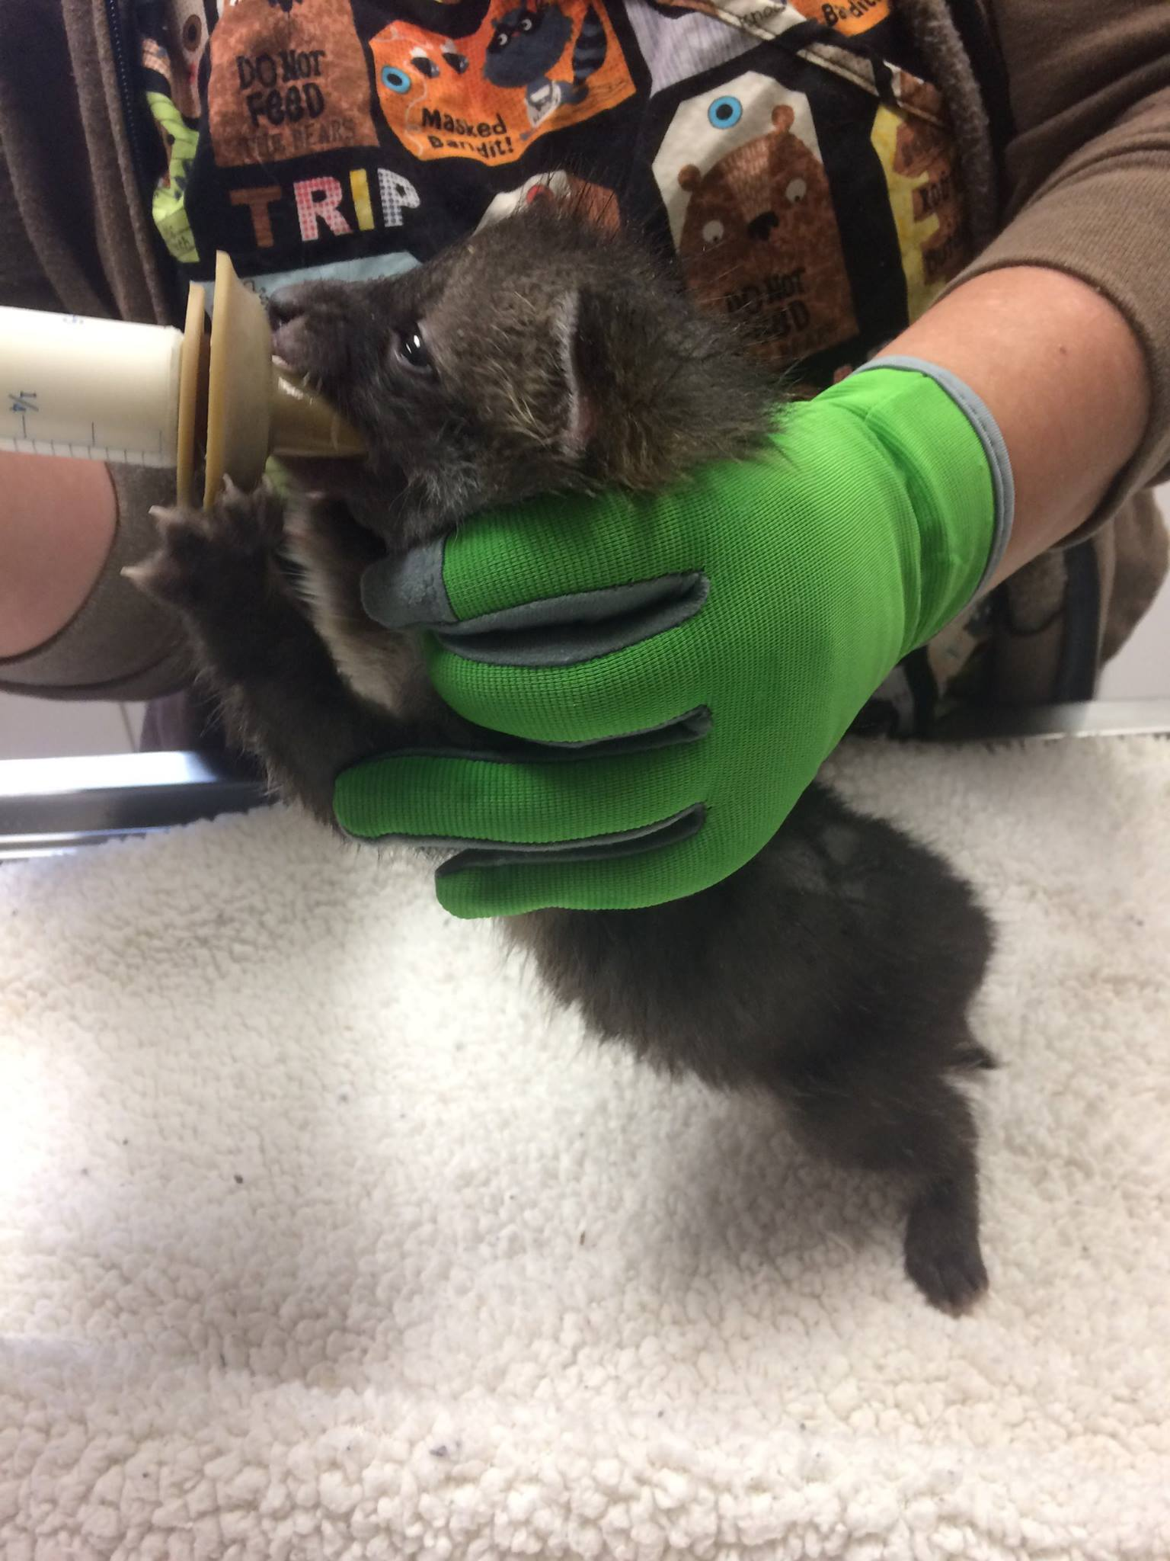
North Country Wild Care hotline:
518-964-6740
Animal Help Now:
AHNow.org or download the app
NYS DEC rehabber listings:
https://www.dec.ny.gov/cfmx/extapps/sls_searches/index.cfm?p=live_rehab

Slide 6
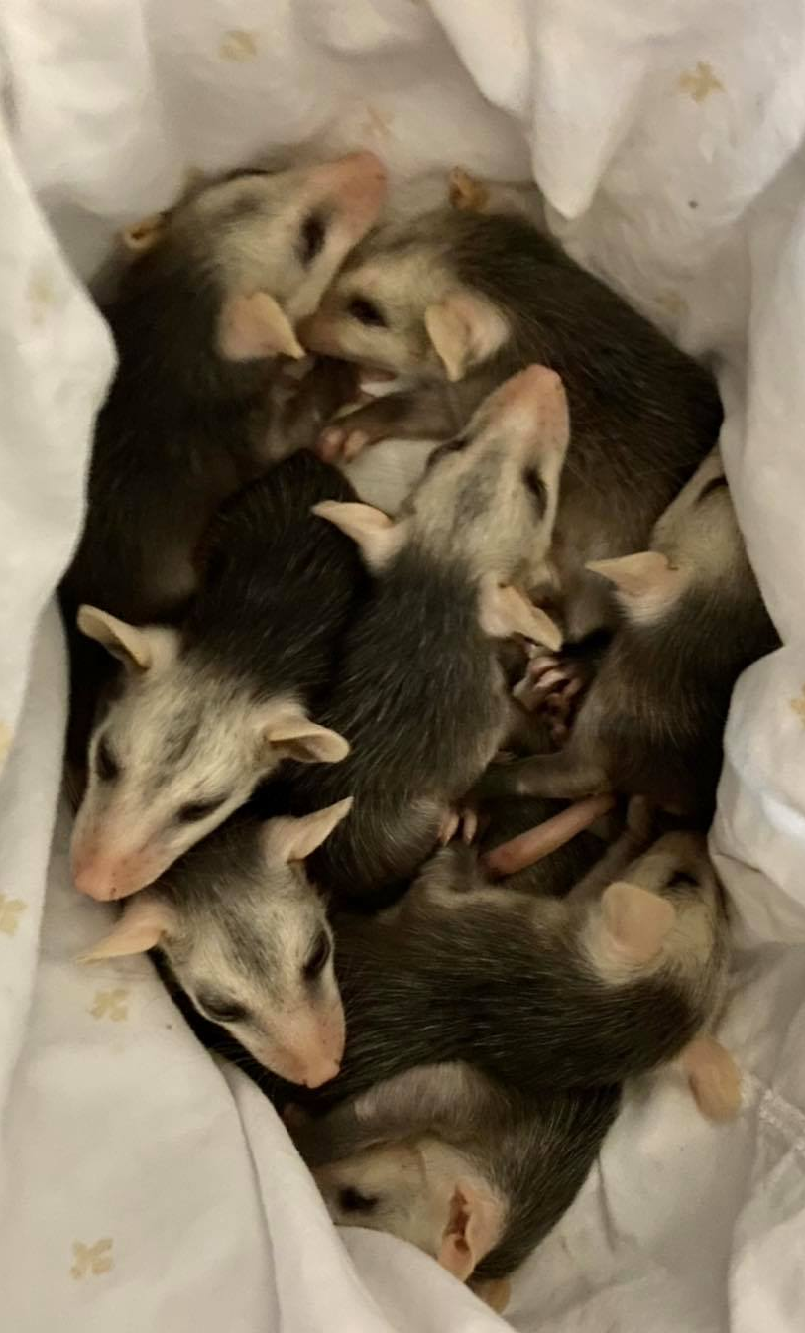
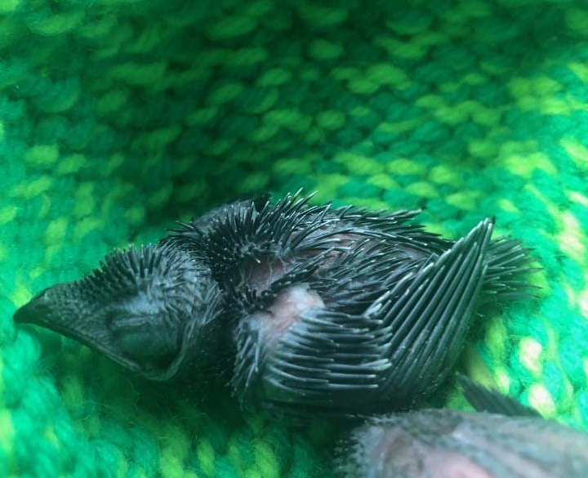
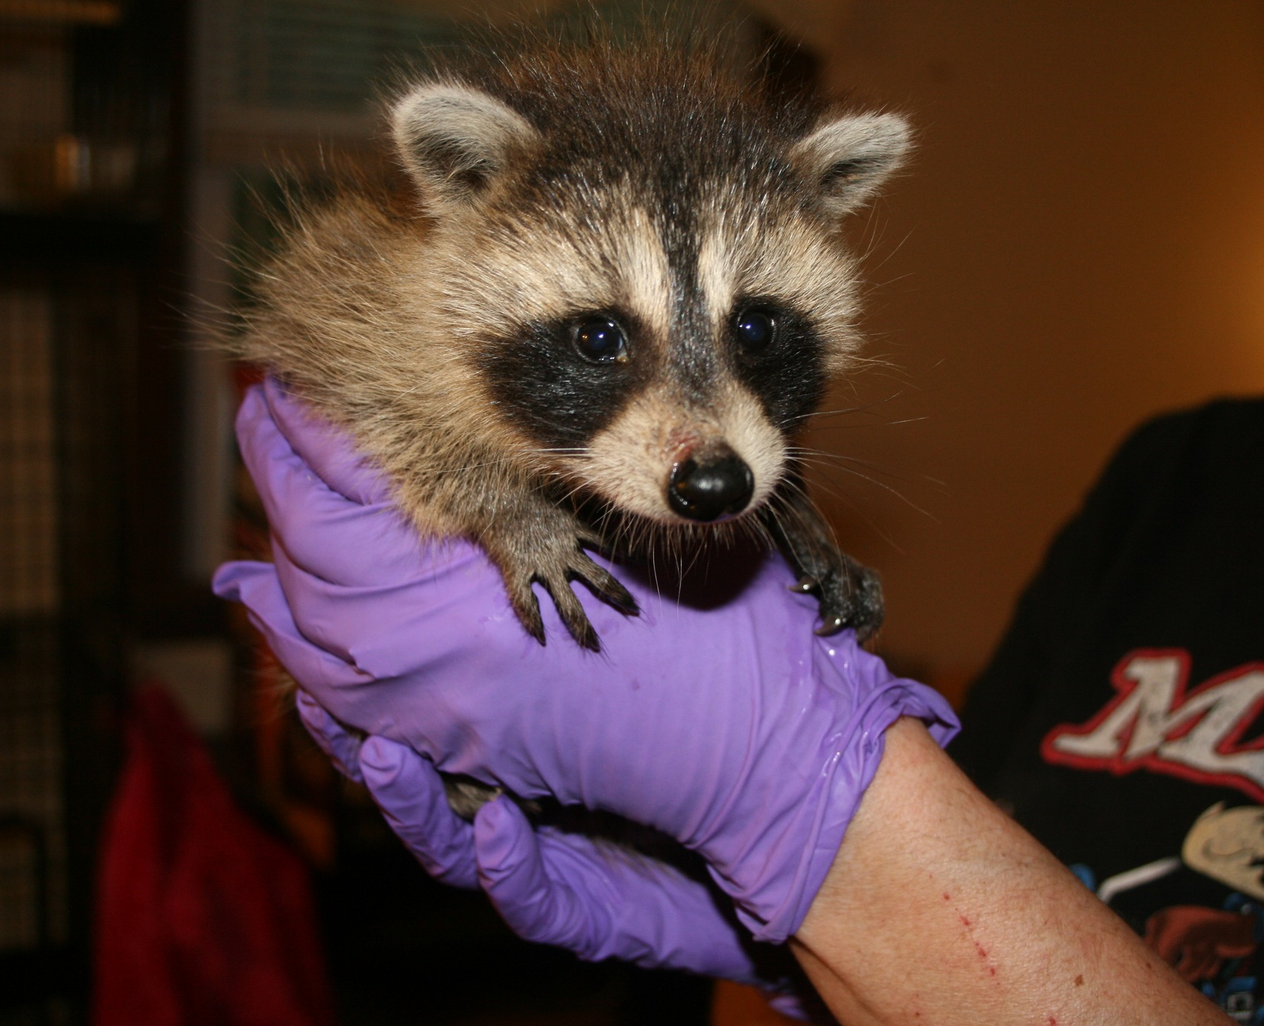
Tips for Wildlife Rescuers
Follow instructions
Avoid handling with bare hands
Keep babies warm

Slide 7
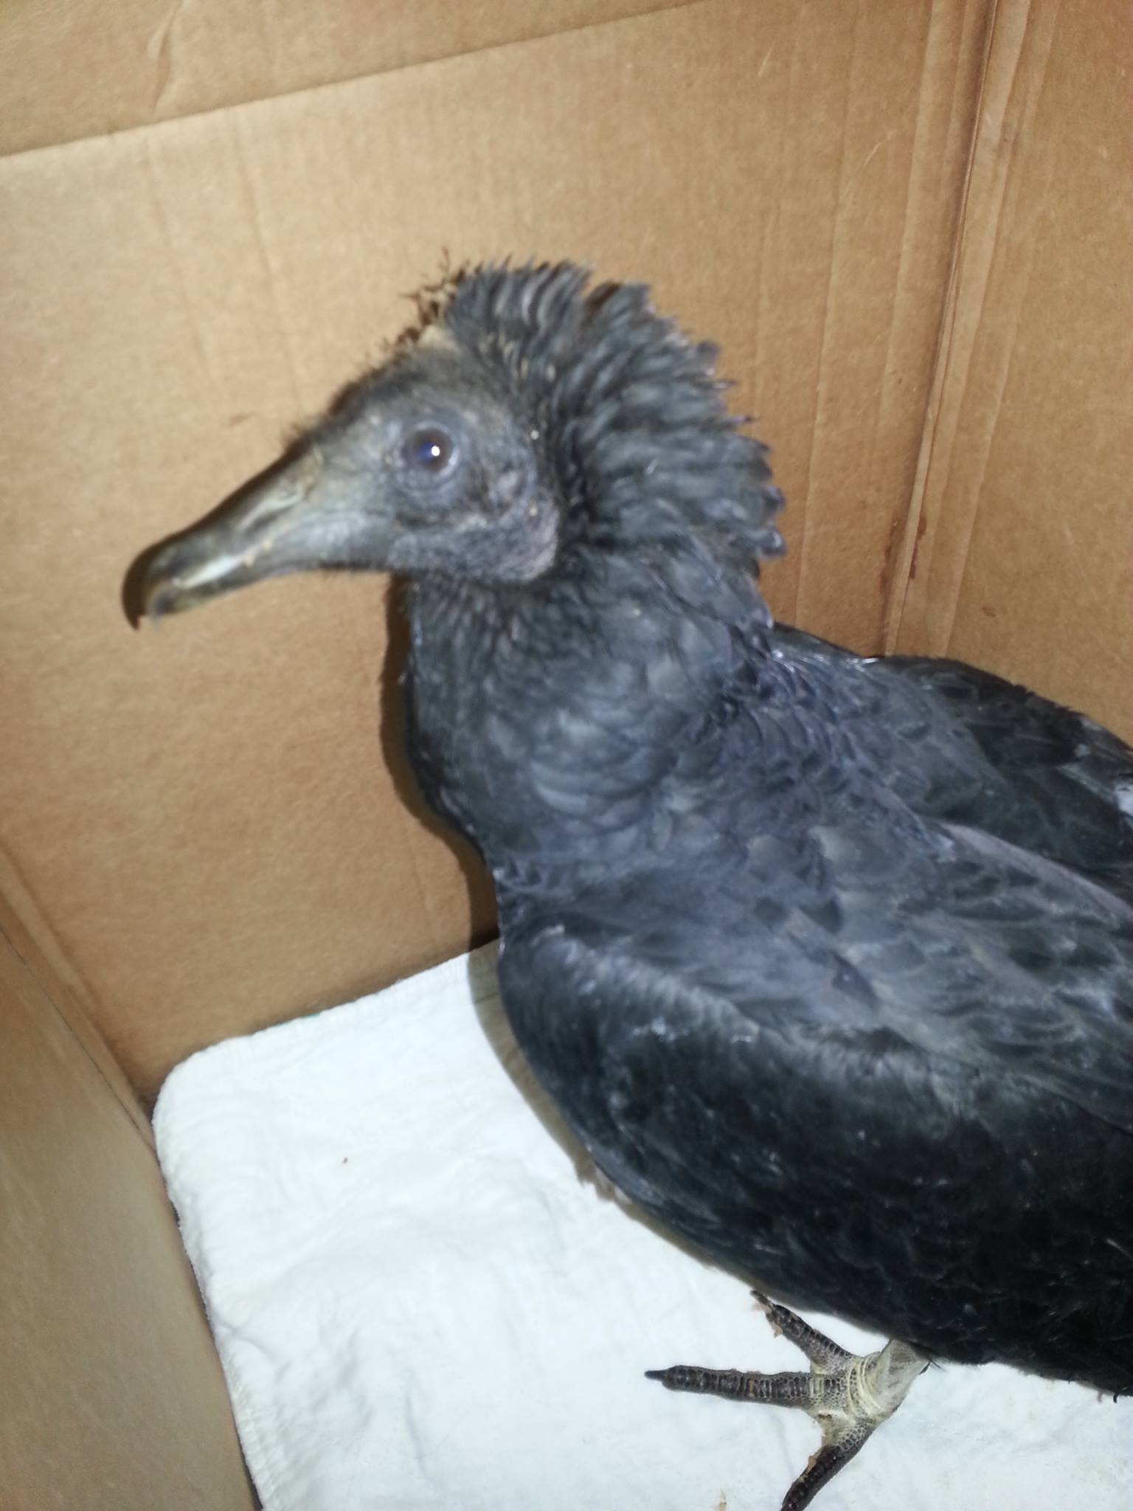
More tips for wildlife rescuers
No food or water unless instructed
Contain the critter

Slide 8
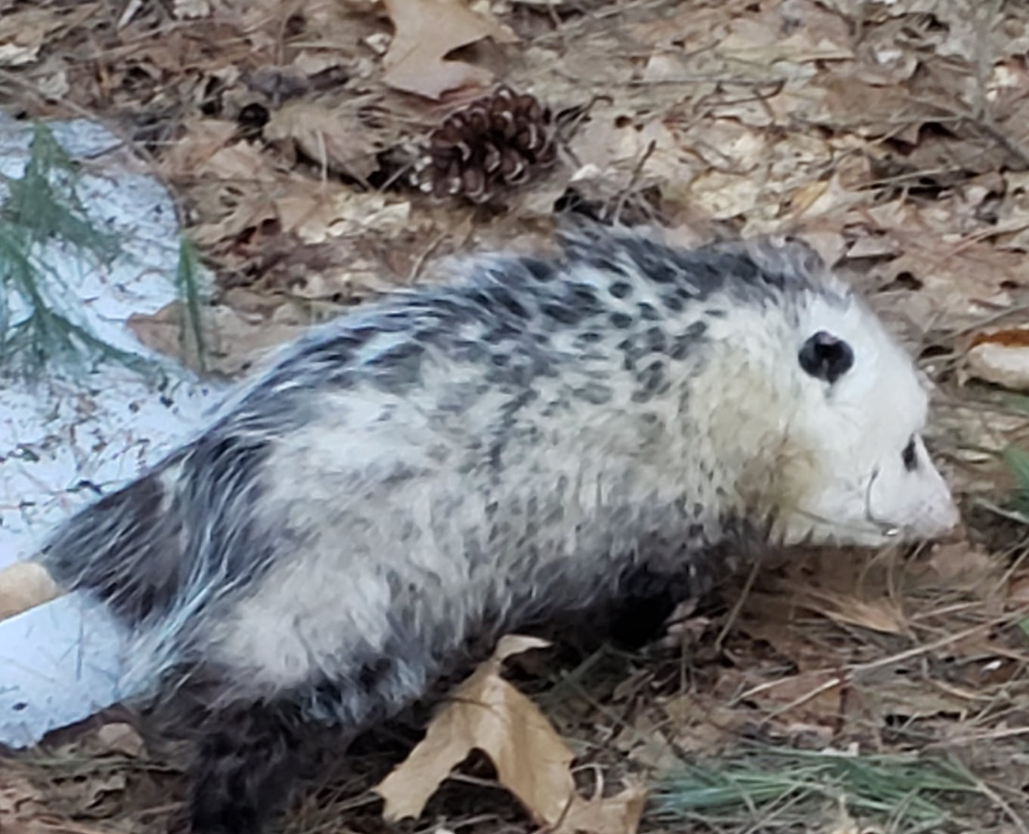
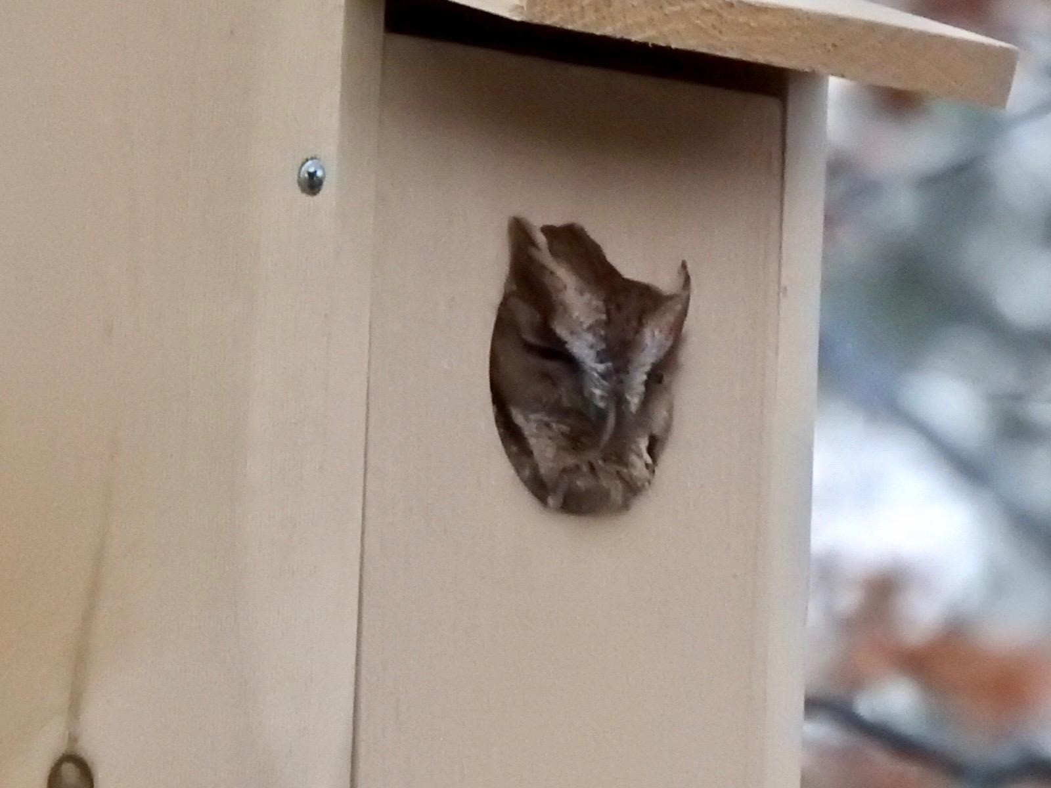
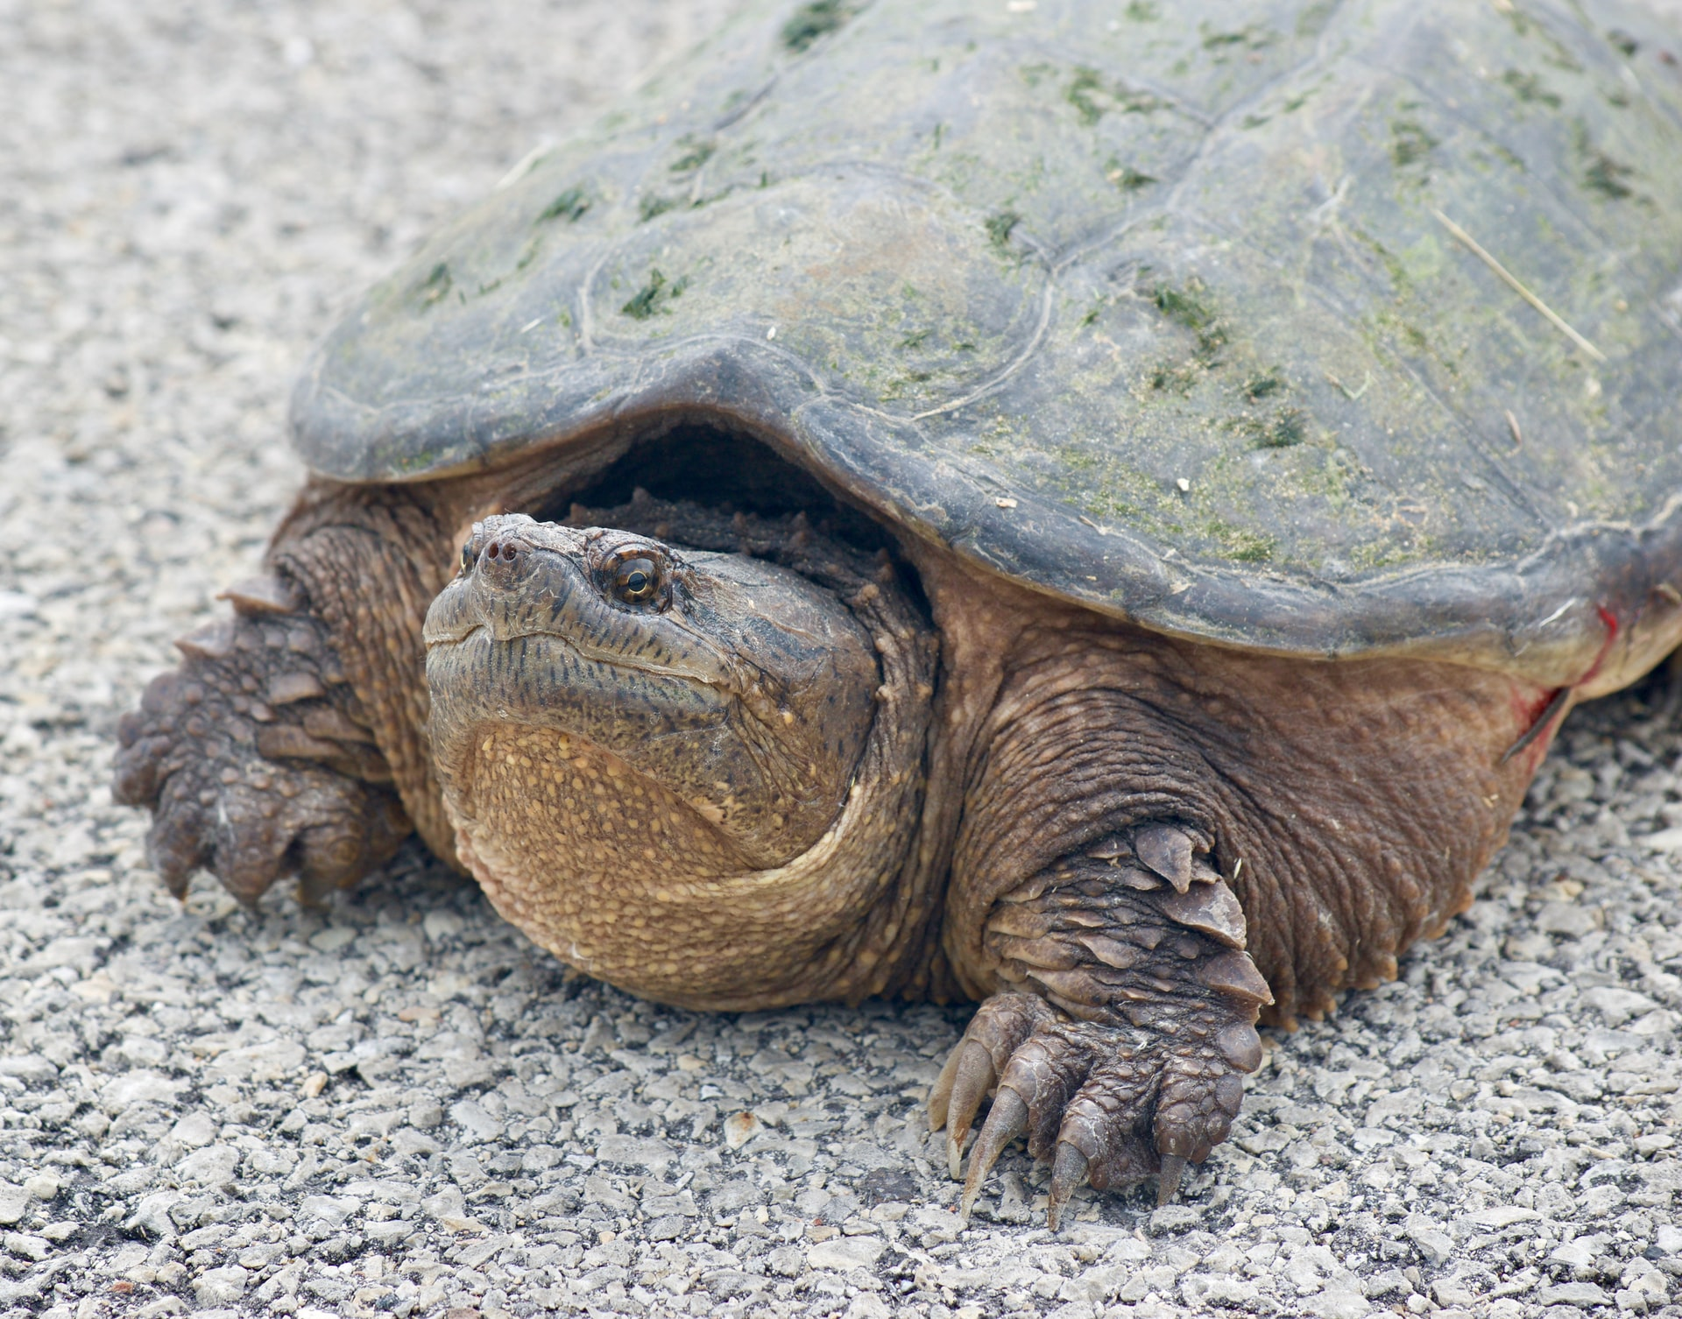
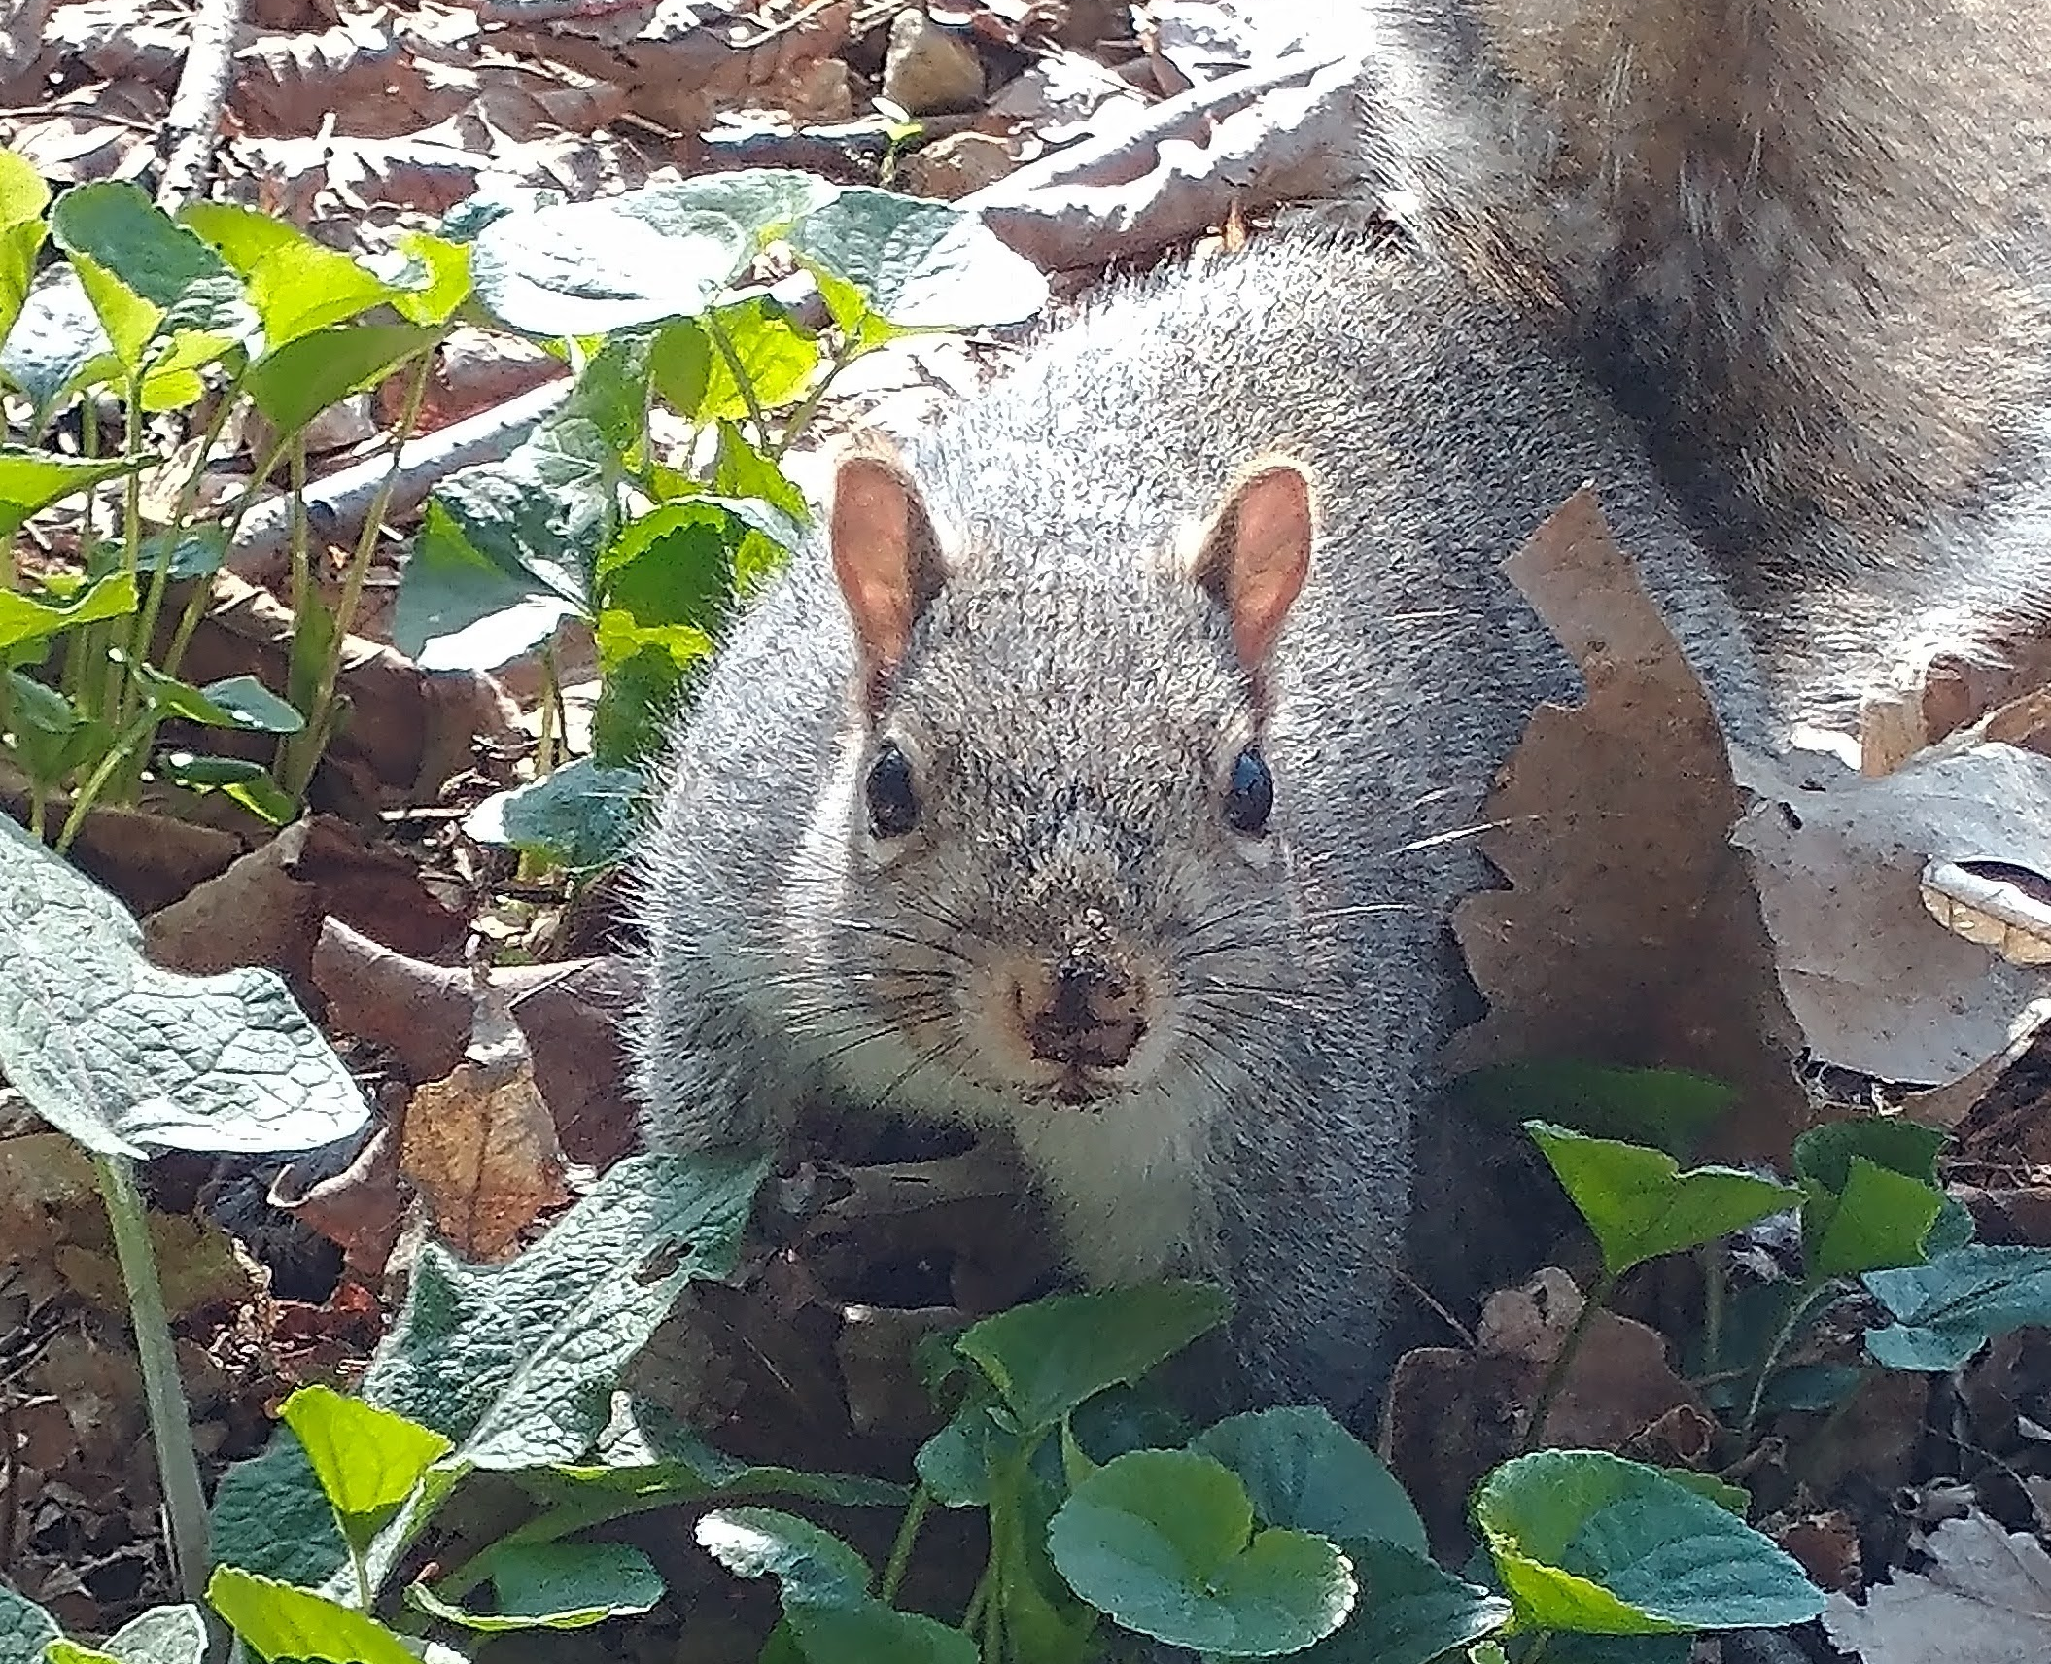
You can help wildlife every day
Be wildlife aware when driving
Learn about your wildlife
Plant natives in your garden
Support habitat restoration
Advocate for safe crossings

Slide 9
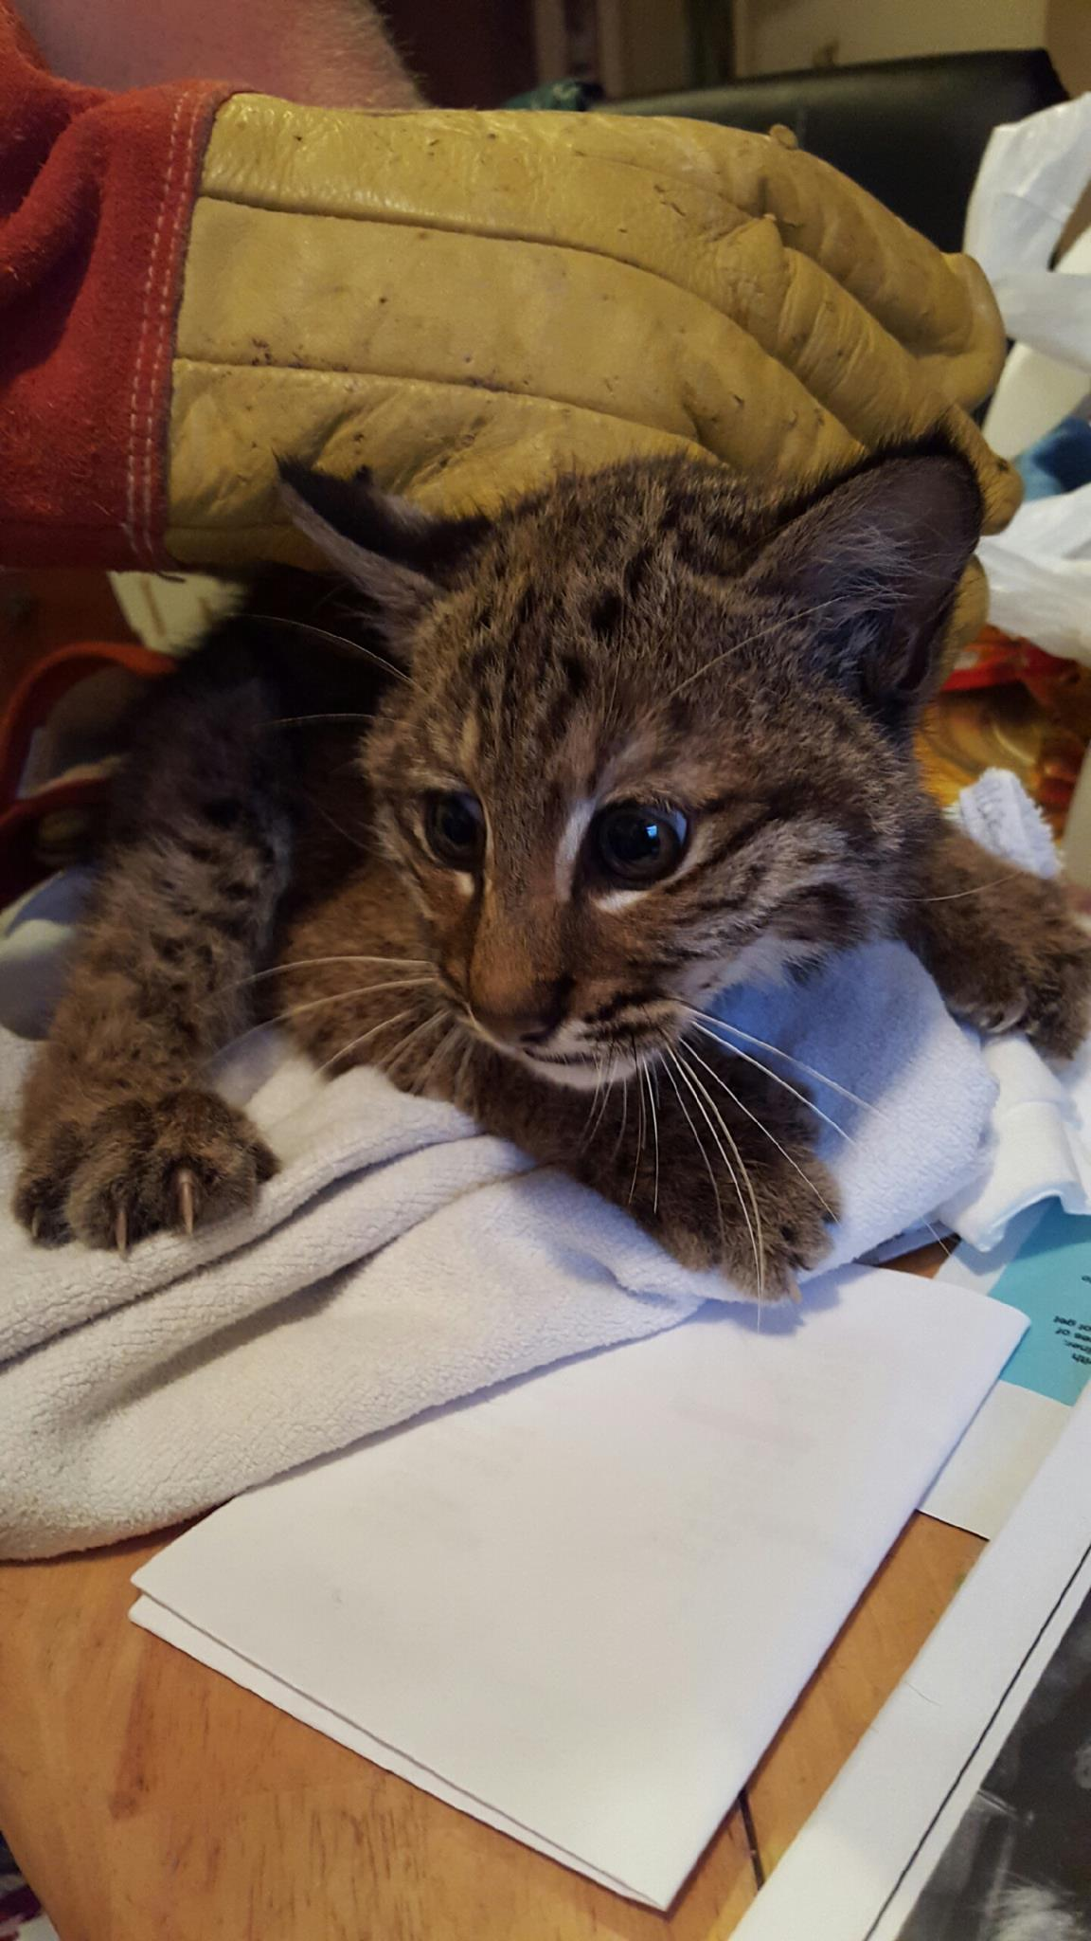
Volunteer!
North Country Wild Care meets the 3rd Tuesday of every month
7:00pm at the Landmark Motor Inn in South Glens Falls
All are welcome to learn more about wildlife rehabilitation and volunteer opportunities
NorthCountryWildCare.org

Slide 10
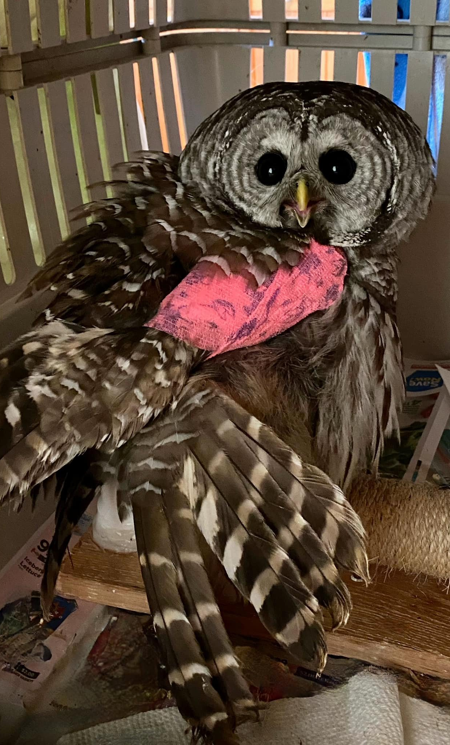
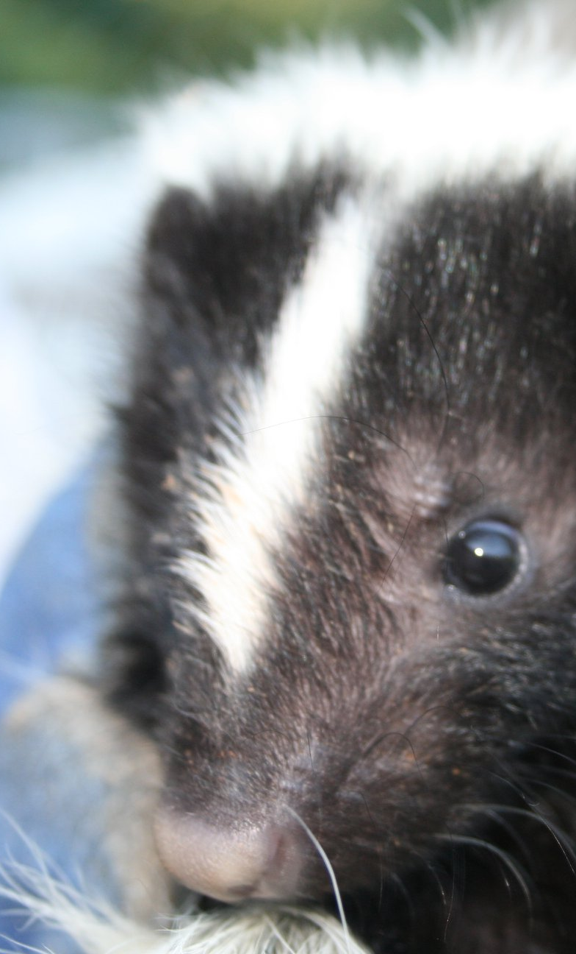
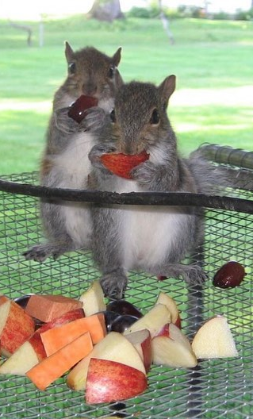
Thank you!

